Slide 1
Chapter 1 Introduction to Computers

Slide 2
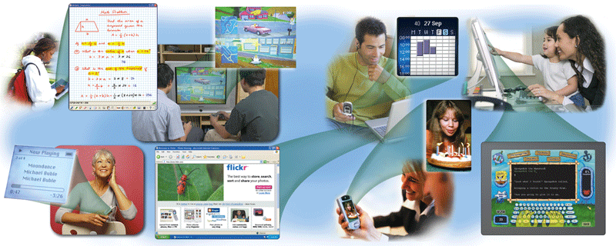
A World of Computers
Computers can take many different forms and their capabilities are constantly expanding.
The gap between computer technology and other allied electronics is narrowing with each passing day but there are basic characteristics that an electronic devise must possess to become a computer.
p. 4-5 Fig. 1-1
Next

Slide 3
Computer
A computer is an electronic device that manipulates information or "data." It has the ability to store, retrieve, and process data.
We may therefore define a computer as an electronic device that is programmable to perform specialized tasks and equipped with an
input device
output device
Central Processing Unit (CPU)
Storage device.

Slide 4
What Is a Computer?
How is a computer defined?
Any electronic device operating under the control of instructions stored in its own memory
Processes data into information
Data that is organized, meaningful, and useful
Accepts data
Raw facts, figures, and symbols
Produces and stores results
p. 6
Next

Slide 5
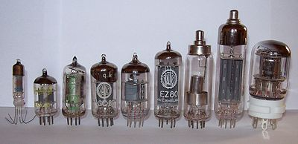
Generation of Computers
First Generation(1946 – 1954)
Main material used was vacuum tubes(electronic valves)

Slide 6
First Generation(1946 – 1954)
Each computer was made of hundreds of such tubes
As a result of the vacuum tubes, this generation of computers was huge in physical size
ENIAC - the Electronic Numerical Integrator and Computer - which was developed in 1946 measured 18 feet by 80 feet and weighed 30 tons
The Computers during this generation were very slow in terms of processing speed.
The use of vacuum tubes made them to generate a lot of heat and had to be used in air-conditioned rooms

Slide 7
First Generation(1946 – 1954)
The heat generated actually affected the life span of the computers and also created air conditioning problems
The computers at this time were very expensive and therefore by the end of 1958 only about 2,500 first generation computers were installed world-wide.

Slide 8
Second Generation of Computers (1954-1962)
The manufacturers replaced the vacuum tubes used in the first generation computers with transistors
These transistors were much smaller in size and more reliable as compared to the vacuum tubes
The second generation of computers was much smaller in physical size as compared to the first generation computers
Faster in terms of processing speed, less expensive and also generated less heat.

Slide 9
Second generation computers started showing the characteristics of modern day computers as they came with utilities such as printers, disk storage and operating systems
Also, the instructions (program) could be stored inside the computer's memory. High-level languages such as COBOL (Common Business-Oriented Language) and FORTRAN (Formula Translator) were used.

Slide 10
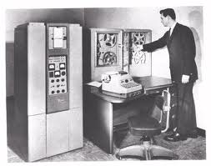
Second Generation of Computers (1954-1962)

Slide 11
Third generation of Computers (1963 – 1972)
The transistors were replaced with Integrated Circuits (ICs, semiconductor devices with several transistors built into one physical component).
This brought a huge gain in computational power
The first ICs were based on small-scale integration (SSI) circuits, which had around 10 devices per circuit
This generation of Computers were cheaper, smaller in size, faster in data processing and generated less heat.

Slide 12
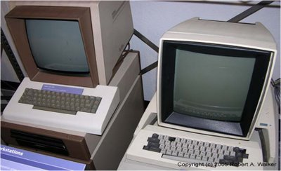
Third generation of Computers (1963 – 1972)
Third Generation Computers (1963-1972)

Slide 13
Fourth generation of Computers (1972 – 1984)
Technically speaking these are the modern day computers.
The fourth generation of Computers were made of Very Large Integrated Circuits (VLICs)
The VLICs (100,000 devices per chip) ensured that millions of components could be fit into a small chip
These computers were cheaper, smaller in size, faster in data processing and generated less heat

Slide 14
Fifth Generation (Present and Beyond) Artificial Intelligence
Fifth generation computing devices, based on artificial intelligence, are still in development, though there are some applications, such as voice recognition, that are being used today.
The use of parallel processing and superconductors is helping to make artificial intelligence a reality. Quantum computation and molecular and nanotechnology will radically change the face of computers in years to come.
The goal of fifth-generation computing is to develop devices that respond to natural language input and are capable of learning and self-organization.

Slide 15
Classification of Computer
Basically, there are three ways of classifying Computers and these are classification by data representation, classification by purpose and classification by processing speed and storage capacity.
Classification by Data Representation
Classification by Purpose
Classification by processing speed and storage capacity

Slide 16
Classification by Data Representation
Computers represent data in different forms. Some represent data in continuous form while others represent data in discrete form. Under classification by data representation, there are three types of Computers and these are
Digital,
Analogue
Hybrid

Slide 17
Classification by Data Representation
A digital computer represents data in discrete form (using 0s and 1s)
Analogue computer represents data in a continuous form (uses continuously variable voltages rather than limiting itself to 0 and 1). Analogue computers are measuring devices for measuring quantities such as temperature, pressure, speed and voltages.
The hybrid computer on the other hand can represent data in both continuous and discrete forms.

Slide 18
Classification by Purpose
Depending on the flexibility in operations, a Computer can be classified as being either a special or a general computer.
Special computers are computers that have been designed for a specific purpose. Apart from this purpose the Computer cannot be used for anything else
General computers on the other hand are computers that are multi-purpose. For example a typical desktop computer can be used for all manner of tasks.

Slide 19
Classification by processing speed and storage capacity
Computers come in variety of types and with a variety of processing and storage capabilities. We may classify computers as follows:
Microcomputers
Minicomputers
Mainframes
Supercomputers

Slide 20
Computers come in variety of types and with a variety of processing and storage capabilities. We may classify computers as follows:

Slide 21
Microcomputers
Also known as personal computers (PCs) are small computers that can only be used by one person at a time. Microcomputers come in various sizes and shapes.
They can be categorized as desktops, towers, laptops and palmtops
The term desktop actually refers to the casing, or the tower. Once you add a monitor, mouse, and a keyboard, you have what is typically known as a desktop computer.

Slide 22
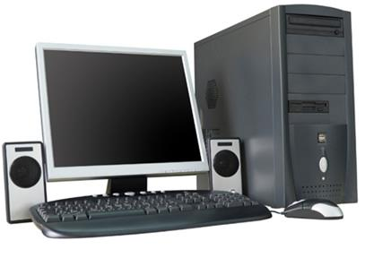
A Typical desktop computer
Figure 1.5 A Typical desktop computer

Slide 23
The second type of computer that you may be familiar with is a laptop computer or laptops as they are often referred to. Laptops are battery or AC-powered personal computers that can be easily carried and used in a variety of locations
A quick glance at the size of a laptop and you might guess that it would be difficult to expand or upgrade.

Slide 24
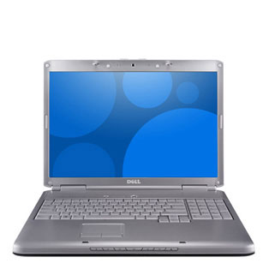
A Typical laptop computer
Figure 1.6 A Typical laptop computer

Slide 25
Minicomputers
These were the main type of computers available in the late 1950s. Unlike PCs, minicomputers or minis – as they are often called – are multi-user and multi-tasks computers
Multi-user - in the sense that they can accommodate more than one user at the same time and multi-task - as they can be made to be executing more than one task simultaneously

Slide 26
Mainframes
Mainframes are an improvement on minis. Very fast medium-to-large size, large-capacity computers introduced in the late 1960s
Their size varies depending on how many people or concurrent users they serve – from few hundred to thousands of people
Because they have larger operational range, they are used in Wide Area Network connecting locations across cities and even countries.

Slide 27
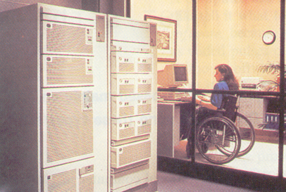
A Mainframe Computer
Figure 1.7 A Mainframe Computer

Slide 28
Supercomputers
A large computer or collection of computers that act as one large computer capable of processing enormous amounts of data.
Supercomputers are used for very complex jobs such as nuclear research or collecting and calculating weather patterns.

Slide 29
Supercomputers
These types of computers were first developed in the 1970s.
Supercomputers are the fastest and the highest capacity computers.
Their cost ranges from hundreds of thousands to millions of dollars.
Among their uses are worldwide weather forecasting, oil explorations, aircraft design, evaluations of aging nuclear weapon systems and complex calculations in mathematical research.

Slide 30
Supercomputers
Supercomputers have hundreds to thousands of processors. One supercomputer Option Red fills about 85 locker-size cabinet of about 1600 square feet at Sandia in Albuquerque, New Mexico in the U.S.A.
Because microcomputers are generally versatile, increasingly powerful, and more affordable than the other types of computers, they are practical tools for organizations to improve their productivity
Whatever their size, speed, and capacity, all computers operate according to similar principles.

Slide 31

Supercomputers

Slide 32
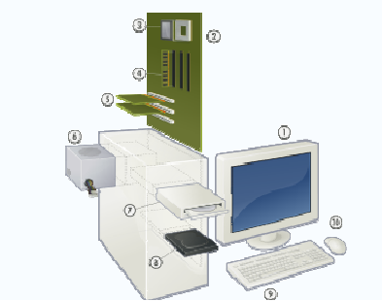
Parts of a Computer

Slide 33
Basic Parts of a Desktop Computer
Monitor:- The two main types are cathode ray tube (CRT) and liquid crystal display (LCD) monitors.
The CRT monitor is big, like a tube television, and takes up a lot of desk space; however, it is the least expensive monitor option.
The LCD monitor is thin and saves energy, but costs more. Over the years you can expect to see fewer CRT monitors if not completely eliminated as LCD monitors become the standard

Slide 34
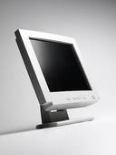

Basic Parts of a Desktop Computer
Figure 1.10a An LCD Monitor Figure 1.10b A CRT Monitor
An LCD Monitor
A CRT Monitor

Slide 35
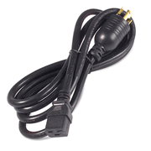
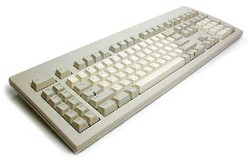
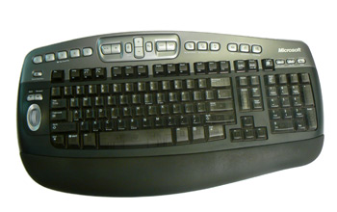
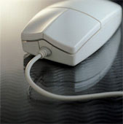
Basic Parts of a Desktop Computer
Power Cord
Keyboard
MouseA Mechanical Mouse
Keyborad

Slide 36
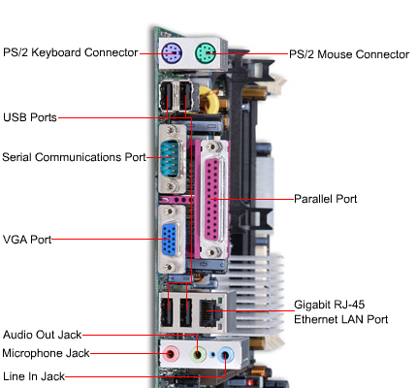
Basic Parts of a Desktop Computer
Figure 1.15 Labeled Back View of Computer Case

Slide 37
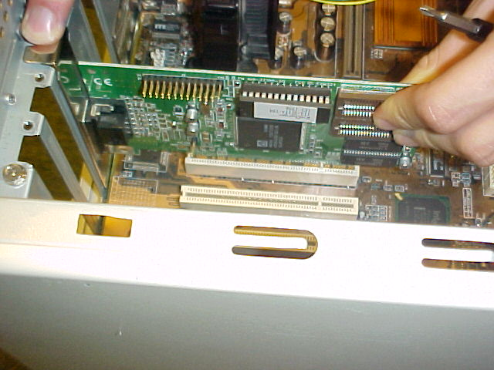
Basic Parts of a Desktop Computer:- An Expansion Board

Slide 38
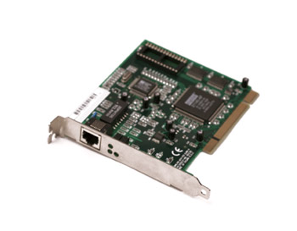
Basic Parts of a Desktop Computer
Network card
The network card allows your computer to communicate over a network1.18 A network card

Slide 39
Communication Devices
Communication devices make it possible for computers to communicate with each other and share information and other resources in a network environment.
When computers are linked together to facilitate some form of communication, such a set up is referred to as a Network.
When the radius of the network is within a short range, the network is called a Local Area Network (LAN) and if the radius spans over long distances like cities and even countries, it is called a Wide Area Network (WAN).

Slide 40
Communication Devices
Computers, though can be “stand-alone” machines, that is, they are not connected to any other computer, connecting computers to communicate and share resources like information and hardware vastly extend the computers range and utility
Computers, though can be “stand-alone” machines, that is, they are not connected to any other computer, connecting computers to communicate and share resources like information and hardware vastly extend the computers range and utility

Slide 41
Communication Devices
Computer communication is accomplished in two ways. We have wired connection and wire-less connection.
Wired connection is implemented with the use of telephone lines and cables
Wire-less connection with the use of microwaves and radio waves

Slide 42
Communication Devices
In the transmission of information from one computer to another, particularly wired connection which is most predominant, a piece of hardware known as modulator-demodulator and commonly called a modem is needed for conversion of signals from digital form into analog form and vice-versa as transmission over telephone lines is in analog form while computer data to be transferred are usually in digital form.

Slide 43
Communication Devices
Other forms of channels are the cables. In this category, we have the coaxial cable and the fiber- optic cable.
Coaxial cable commonly called “co-ax”, consists of insulated copper wire wrapped in a solid or braided metal shield, then in an external cover. Co-ax is mostly used for cable television and to connect parts of a LAN over a long range.

Slide 44
The two common binary coding schemes normally used in data representation are the ASCII – and EBCDIC – codes.
ASCII, which is an acronym for American Standard Code for Information Interchange, and pronounced as “as-key”, was later extended to accommodate more special characters and the latter version was referred to as extended ASCII or ASCII-8.
The latest of the versions is the ASCII-16 coding scheme which uses 16 bits. ASCII is the most widely coding scheme used in microcomputers.

Slide 45
Unicode or ASCII-16 which is a version of ASCII uses 2 bytes (16 bits) to represent a character, instead of 1 byte (8 bits) and therefore can handle 65,536 characters rather than just 256
EBCDIC, pronounced as “eb-see-dick”, and stands for Extended Binary Coded Decimal Interchange Code is the most widely used scheme in mainframe computers. Table 1.1 shows the codes for the uppercase alphabetic letters and numerical digits, 0 to 9. (See Table 1.1)

Slide 46
Table 1.1

Slide 47
Machine language
Machine language – the language that the computer “speaks and understands” – is the binary programming codes which can be processed directly.
Instructions in machine language consist of series of 0s and 1s which could be quite tedious to read and write to humans.
Software package that run on IBM compatible PC running Windows may not work on Apple Macintosh.
This is due to differences in their underlying hardware, particularly, the processor on which they are running.

Slide 48
Machine language cont’d
Thus each model or family of processors has a unique machine language.
To circumvent this problem, programmers write in special programming languages – high level languages – that more closely resemble human languages.
Codes in these high level languages such as BASIC or C++ are then translated by system software programs called language translators or compilers into the machine language that the particular type of processor can “understand”.

Slide 49
Inside The Microcomputer
The box that contains the microcomputer’s processing hardware and other components is called the system unit.
Components that are inside the system unit includes the power supply, the motherboard, the microprocessor, specialized processor chips, RAM chips, ROM chips, other forms of memory – cache, VRAM, flash – expansion slots and boards, ports, bus lines, PC slots and cards.
The hard disk drive, a diskette drive, and a CD-ROM drive among components are also found inside the system unit.

Slide 50
Inside The Microcomputer cont’d
For now let us concern ourselves with the following parts of the system unit:
Power supply
Motherboard
Microprocessor
RAM chips
ROM chips
Other forms of memory - cache, VRAM, flash
Ports
Expansion slots and boards
Buses, PC slots and cards

Slide 51
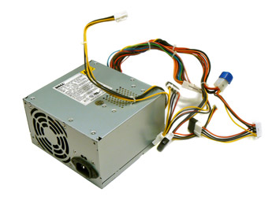
Power supply
The power supply is the device that converts power from AC to DC to run the computer.
The electricity available from a standard wall outlet is an alternating current (AC) but microcomputers run on direct current (DC).
The on/off switch in the computer turns on or shut off the electricity to the power supply.
Figure 1.20 A Power Supply

Slide 52
Power supply cont’d
As electricity generates lots of heat, a fan is provided to cool the components and prevent them from getting too hot.
For precaution sake, it is advisable to connect your computer to an uninterrupted power supply (UPS) or surge protectors instead of connecting it directly to the electricity power outlet

Slide 53
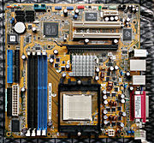
The Motherboard
Also known as the system board, the motherboard is the main circuit board in the system unit.
It's a thin plate that holds the CPU (Central Processing Unit), RAM, ROM chips and other forms of memory, connectors for the hard drive and optical drives.
A Typical Motherboard

Slide 54
The Motherboard
It also houses the expansion cards to control the video and audio, as well as various external ports and peripherals.
The motherboard connects directly or indirectly to every part of the computer.

Slide 55
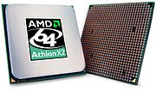
The Microprocessor (CPU/Processor)
The Central Processing Unit (CPU), also called a processor, is located inside the computer case on the motherboard.
It is often called the brain of the computer, or the computer's engine.
Figure 1.22 A Typical Memory Chip

Slide 56
The Microprocessor (CPU/Processor) cont’d
Its main function is to interpret the various instructions in a given program.
The processor has two main components namely the Arithmetic-Logic Unit (ALU) and the control Unit (CU).
The ALU is the component that performs all the arithmetic and the logical operations, that is, operations such as addition, subtraction, multiplication, division and comparison of two or more items are all done by the ALU.

Slide 57
The Microprocessor (CPU/Processor) cont’d
The CU is the unit that fetches the next instruction to be executed from the main memory.
It decodes the fetched instruction and issues appropriate command to the ALU, the memory or the input/output controllers for the execution of the instruction.
The CPU is generally a 2 inch ceramic square with a silicon chip located inside. The chip is usually about the size of a thumbnail.
The CPU fits into the CPU socket, which is covered by the heat sink, an object that absorbs heat from the CPU.

Slide 58
There are many processor manufacturers for personal computers including Intel, Cyrix, VIA, and AMD.
Today, the clock speed of a processor is measured in giga Hertz (GHz).
Two identical processors having different clock speeds will run at different speeds.
The processor with the higher clock speed will execute instructions faster than the one with a lower clock speed.

Slide 59
RAM CHIPS
The main memory or the RAM (random access memory), is the temporary work space for the processor.
Remember we said the main memory is the workbench for the processor.

Slide 60
RAM CHIPS
It temporary holds data and instructions that will be needed shortly by the processor.
RAM is like a notepad that is constantly being written onto, then erased, and then written onto again.
RAM (Random Access Memory) is your system's short-term memory.
Data is temporarily stored here until you save your work to the hard disk.
RAM is used by the system to store data that is processed by a computer's CPU.

Slide 61
RAM CHIPS
This short-term memory disappears when the computer is turned off, so always save your file before turning off the machine.
When you save a file, you are saving it to long-term storage that does not disappear when the computer is turned off.
If the RAM is insufficient to run software, the computer will place part of the software and data on the secondary memory.
This means that the computer will constantly be swapping data back and forth between RAM and disk thereby slowing down rate of processing.

Slide 62
ROM Chips
The Read Only Memory (ROM) chips also called firmware, cannot be written on or erased by the computer – as the name suggests, its content can only be read.
Firmware is the term that is used for software permanently stored on a chip – microprogrammed.
If we say that RAM chips temporarily remembers (information supplied by the user or software), then ROM chips can be said to permanently remember (information supplied by the manufacturer).

Slide 63
ROM Chips
ROM chips contain instructions that need to be available at all times for the computer to “get up and run”.
One of these is the bootstrap – instructions that tell the computer what to do when it is switched on or booted.
To get the computer going, a ROM also performs a “power-on-self-test” (POST).
There are three variations of ROM chips that are used in special situations. The three variations are PROM, EPROM, and EEPROM.

Slide 64
ROM Chips cont’;d
PROM: Programmable Read - Only Memories are blank chips on which instructions or programs are written using special equipment. Once the program is written, it cannot be erased. Some microcomputer software packages come on PROM units.
EPROM: Erasable Programmable Read Only Memories are like PROM chips except that the contents can be erased, using special equipment and new data or instructions can be written. A special device that uses ultraviolet light is used to erase its content.

Slide 65
EEPROM Chips
EEPROM: Electronic Erasable Programmable Read-Only Memory can be reprogrammed using special electrical impulses. The advantage of EEPROM chips is that they need not be removed from the computer to be reprogrammed.

Slide 66
Computer Memory Capacity
How much data – in other words, how many 0s and 1s – a computer memory or a storage device can hold is very important for its operation.
As we already mentioned, a 0 or 1 occupies one bit of memory space.
A character consists of eight bits thus occupies eight bits of memory space.
As data are keyed into the computer in characters, bits are grouped into eight bits – 1 byte.
A Byte is used to hold a letter, number, or a special character (such as *, &, $, etc).

Slide 67
The kilobyte is the common unit of measure for internal memory of microcomputers.
An average printed page such as in this book would take up about 2500 bytes or 2.5 kilobytes of memory space.
A Megabyte (MB) is about 1 million bytes. Precisely 220 bytes (1,048,576 bytes) or 210 KB.
Capacities of secondary memory devices – such as floppy diskettes – are often expressed in megabytes.
A floppy diskette for example has a capacity of 2 MB.

Slide 68
A Gigabyte (GB) is about 1 billion bytes.
Precisely 230 or 1,073,741,824 bytes or 210 MB.
This measure is often used to measure the capacity of hard disks of microcomputers or PCs, CD-ROMs and main memory capacity of mainframes and supercomputers.
A Terabyte (TB) represents 1 trillion bytes or 240 bytes or precisely 1,009,511,627,776 bytes.
Supercomputers main memory capacities are expressed in terabytes.

Slide 69
RAM Capacity, Word Size and Processing Speed
The power of supercomputers, mainframes, minicomputers, workstations, microcomputer, and microcontrollers is measured according to three main parameters: RAM capacity, wordsize capability, and processor speed.
There are other deciding factors, though these three are the most important.

Slide 70
RAM Capacity
Remember we said the main memory to the computer is what a workbench is to the craftsman or the carpenter.
The more spacious the workbench is the more convenient and voluminous the work that can be done on it.
The capacity of the RAM therefore determines how large the software that can be run on any computer and how fast it can run.

Slide 71
WordSize
The next deciding factor of the power of a computer is its wordsize – the number of bits its register can hold and process at one time and can be transferred to and from memory, output / input devices and remote sites through its internal bus – electronic highway.
A 32-bit processor will process data and instructions in 32-bit chunk and a 64-bit processor in 64-bit chunk thereby being twice faster.
It should be noted that expansion bus capacity (also measured in word size), the capacity of the bus that connects the processor, RAM, and registers to the peripherals of the computer also plays a major role.

Slide 72
Processor Speed
Processor speed is measured in three ways with respect to the frequency of its system clock (in megahertz), the number of instructions processed per second and floating-point operation per second.
Every computer contains an internal timing device that is switched on when the power of the computer is turned on.
This device is called the system clock. The system clock controls the pace at which all operations take place.
The faster the clock, the faster the processing.

Slide 73
Microcomputer processing speeds are often measured in megahertz (MHz), with 1 MHz equal to 1 million machine cycle or beats per second.
Average speed of PCs of toady ranges between 550 – 800 MHz. It is not uncommon today to find PCs running on Pentium IV processors at 1800 MHz (1.8 GHz) or even faster.
Processing speed of Workstations and Mainframes are often measured in number of instructions processed per second (IPS) which currently runs into millions.
Thus, MIPS (million of instruction per second) is a measure of computer processing speed.

Slide 74
For Supercomputers, processing speed is often measured in flops – floating-point operation per second.
Floating-point operation is a special kind of mathematical calculations.
This measure is often expressed in megaflops (millions of floating-point operations per second), gigaflops (billions of floating-point operations per second) and teraflops (trillions of floating-point operations per second).

Slide 75
Other Forms of Memories
RAM is divided into two sections with one section relatively large and called the main RAM.
The other section called the cache memory being tiny and containing few but more expensive chips.
Cache memory is a special high-speed memory area that the processor can access quickly.
It serves as a buffer (or bridge) between the processor and the main RAM.
A special program transfers data and instructions that were transferred to the RAM from the RAM to the processor to minimize swapping of instructions back and forth the secondary storage by the processor and thus enable it run faster.

Slide 76
Video RAM (VRAM) or video memory chips are used for storing and displaying images on the monitor.
The capacity of VRAM determines how fast images are processed and how many colors can be used to display images.
VRAM chips are mounted on a special but small board known as video adapter card.
Video adapter cards are usually inserted in an expansion slot on the motherboard.

Slide 77
Another form of memory is the flash RAM cards that consist of circuitry on a credit-card-size plate or card.
Flash RAM cards are derived from EEPROM and are non-volatile.
They are used to simulate main memory and also to back up or supplement the hard disk drives.

Slide 78
input/ output and STORAGE DEVICES
Learning Objectives
After reading this unit you should be able to:
Identify the various hardware devices
Explain how data is represented internally by the computer
Distinguish between the different types of file

Slide 79
Input and Output Devices
Input / Output devices or simply I/O devices translate all data going into the computer into series of binary digits of 0s and 1s which is what the computer understands.
They also translate back these binary digits coming out of the computer into characters that are understandable by humans.

Slide 80
Input Devices
Input devices include keyboards, pointing devices, and source-data entry devices like scanners and digital cameras as well as voice and audio/video input devices like microphones and video cameras.
The most common input device and the one you will probably have to learn how to use is the keyboard.
The computer keyboard unlike the ordinary typewriter keyboard converts letters, numbers, and other characters into electrical signals in machine language and can be processed by the computer processor.

Slide 81
Input Devices
Other devices that are commonly used in conjunction with the keyboard are pointing devices like the mouse. These devices control the position of the cursor – pointer on the screen. Pointing devices include:
Mice, trackballs, and joysticks
Light pens
Digitizing tablets
Pen-based systems

Slide 82
Input Devices
Data-entry devices that do not require keyboard for inputting data include the following:
Scanners
Voice-recognition devices
Audio input devices
Video input devices
Digital cameras
Often times we find keyboard, pointing device and other source-data entry devices like scanners combined in a single computer systems.

Slide 83
Keyboard
The keyboard is the commonest input device. It is usually connected to the system unit of the computer through a serial port with a cable.
The keys on the keyboard can be divided into four groups namely:
Standard keys
Cursor-movement keys
Numeric keys
Function keys

Slide 84
Keyboard
The Standard typing keys are similar to that of the typewriter with the familiar QWERTY arrangement of letter, number, and punctuation keys.
QWERTY refers to the alphabets in the top left row on the standard typewriter keyboard.
On the computer keyboard, it can be found on the third row.
The Caps Lock, Shift, and Tab keys and also the Space bar work the same way as they do on a typewriter keyboard.
The Caps Lock key is a toggle key

Slide 85
Keyboard
The Enter key that works like the return key on a typewriter – and even often referred to as the Return key – is used to send commands to the computer, in addition to beginning a new paragraph in a word processing environment.

Slide 86
Keyboard
Cursor-movement keys – sometimes called the arrow keys – are use to move the cursor around the text on the screen.
The cursor is the blinking vertical bar on the screen that indicates insertion point or where data may be entered next.
The cursor-movement keys move the cursor left, right, up, or down.
Keys labeled Page Up and Page Down move the cursor the equivalent of one screen (page) up (backward) and down (forward) at a time respectively

Slide 87
Keyboard
Numeric keys are laid out separately on the numeric keypad – a separate set of keys, 0 through 9 like those on a calculator – on the standard 101-key keyboard previously known as the AT-style keyboard
The numeric keypad serves two purposes.
With the Num Lock key off, the numeric keys duplicate as arrow keys for the movement of cursor and perform other functions such as Page Up and Page Down.
And when the Num Lock is on, the keys may be used for entering numbers, as on a calculator.
The Num Lock key is also a toggle key

Slide 88
Keyboard
However, to maintain keyboard standard the numeric keys can also be found on the second row of keys with other special characters just like the typewriter keyboard.
Function keys are the keys labelled F1, F2 through F12.
These keys are not used for typing but rather for issuing commands.
Desktops normally have 12 function keys while some portables like notebooks have only 10.
The function that each of these keys perform are however software-specific.

Slide 89
Audio Input Devices
An audio input device records or plays analog sound and translates it for digital storage and processing.
Voice-recognition devices are only one kind of audio input device which can translate music as well as other sounds.
Analog sound is converted to digital data through sampling – the number of times per second analog sound is turned into binary digits.

Slide 90
Video Input Device
Like sound, video or photographic images are captured in analog forms with the signals being continuously varying waves.
The signals that come from a VCR or a camcorder has to be converted into digital form through a special video card installed in the computer.
The most common video cards are Frame-grabber and Full-motion video cards.
Frame-grabbers can capture and digitize only one frame at a time.
Full motion cards can convert analog to digital signals up to 30 frames per second (TV quality), giving effect of continuous flowing motion picture.

Slide 91
Pointing Devices
The principal pointing tools used with microcomputers are the mouse, the trackball, the joystick, and the touchpad.
A mouse is a device that is rolled about on a desktop to direct a pointer on the monitor.
The mouse pointer is the symbol that indicates the position of the mouse on the display screen.
It may be an arrow, a rectangle, or even a representation of a person’s pointing finger.
It may change to an I-beam to indicate that it is a cursor identifying the place where text or other data may be entered.

Slide 92
Mouse
The mouse is usually connected to the system unit by plugging it into a port or socket at the back of the unit using a cable.
A ball under the mouse translates the mouse movement into digital signals and on top of the mouse are one to four buttons depending on the variation of the mouse.

Slide 93
Trackball
A trackball is a movable ball, on top of a stationary device, that is rotated with the fingers or palm of the hand.
It looks like the mouse turn upside down; instead of moving the mouse around, you move the trackball with the tips of your fingers.
Trackballs are specially suited for portable computers like laptops which are often used in confined working environments such as airline tray tables.

Slide 94
Joystick
A joystick is a pointing device that consists of a vertical handle like a gearshift lever mounted on a base with one or two buttons.
Joysticks are principally used in some computer-aided (CAD) systems, computerized robot systems, and in video games.
Mostly found on laptops, touch pads are flat-top rectangular devices that let you control the cursor/pointer by rubbing your finger on the surface of the pad.
A click action is accomplished by tapping on the pad’s surface

Slide 95
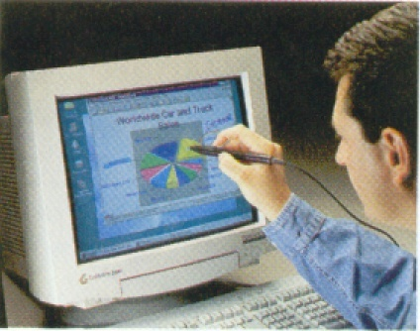
Light pen
The light pen is a light-sensitive device that is connected to the computer terminal.
The user points to a desire location on the monitor and presses the pen which then sends the signal corresponding to the location to the computer.
Light pens are used by graphic designers, engineers, and architects.
A light pen in use

Slide 96
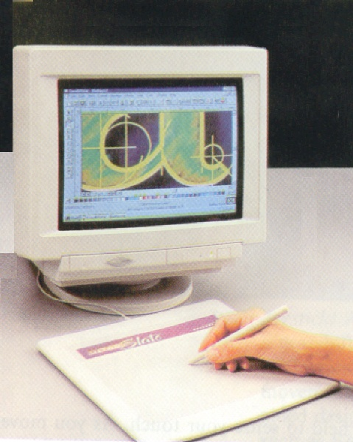
Digitizing Tablets
A digitizing device consists of a digital tablet that is connected to a stylus or a puck.
A stylus is pen-like device that is used to sketch images in digitized form.
A puck is a copying device that the user uses to copy or trace an image.
Digitizing tablet in use

Slide 97
Digitizing Tablets
A digitizing tablet used with a stylus enables the user to paint “naturally” and achieve effects similar to what an artist will achieve using pen, pencil, or charcoal.
Alternatively, a digitized copy of a painting can be traced and stored into the computer by laying the painting or drawing on the tablet.
Digitizing devices are used primarily by artists and graphic designers.

Slide 98
Scanning Devices
Hardcopies of graphic images such as drawings and photos are translated into digital form by scanners using laser beams and reflected light.
The images can be processed by a computer, displayed on a monitor, stored on a storage device, or communicated to another computer.
Types of scanners include Bar-code readers, Mark- and character-recognition devices, Fax
machines, and Imaging systems.
Get image.

Slide 99
Digital Cameras
Unlike analog video cameras which convert light intensities into infinitely variable signals, digital cameras convert light intensities into discrete 0s and 1s.
Digital cameras have enjoyed wide popularity in industrial photography and journalism because the images are instantly available, can be deleted to make storage available for more photos, and can be transmitted over telephone lines.
Get image

Slide 100
STORAGE DEVICES
Storage devices are media for storing data. Often referred to as secondary storage, storage devices can range from a personal computer diskette drive with a diskette holding the text of a letter to a giant video server of the type being developed to store and distribute thousands of movies over cable channels.

Slide 101
STORAGE DEVICES
As we learned, the data you are working on is stored in the RAM (primary storage) in an electrical state during processing.
Because RAM is an electrical state, data in RAM disappears when you turn off the power to your computer.
For this reason, you must save your work onto a storage device that stores data permanently – until it is intentionally or accidentally erased – such as a floppy diskette, a pen drive or a hard disk before you turn off your microcomputer.

Slide 102
STORAGE DEVICES
Computer software or programs in additions to data must be stored in a computer-usable form.
Software instructions must be retrieved from a permanent storage device and placed into RAM for any processing to take place.
Special software – the operating system – is responsible for the way data and programs are stored on the secondary storage devices.

Slide 103
STORAGE DEVICES
Generally, a secondary storage can be likened to a file cabinet in which files (data) are stored until they are needed.
Then you open the drawer, take out the appropriate folder or file, and place it on top of your desk (in primary storage, or RAM), where you work on it – either to write some few things on it or to remove and throw some few pages away.
However, in the case of electronic documents, you are actually taking out a copy of the desired file and putting it on the desktop.

Slide 104
STORAGE DEVICES
The original file remains in the file cabinet (secondary storage) while the copy of the original is being edited or updated on the desktop (in the RAM).
After working on the file, you take it off the desktop (out of primary storage) and return it to the cabinet (secondary storage). Thus the updated file replaces the original file.

Slide 105
Data Representation and Storage Capacity
In fact all forms of data whether text, numeric, or graphic objects are transformed and represented in the computer memory as binary digits (0s or 1s) character by character or point by point in the case of graphic objects such as pictures.
Each character occupies one byte of memory space. As explained earlier, these bytes are grouped into higher denominations such as kilobyte, gigabyte, and terabyte for ease of computation.

Slide 106
Data Representation and Storage Capacity
Kilobyte (KB): 210 or 1024 bytes.
Megabyte: (MB): 220 or 1 million bytes (round off)
Gigabyte (GB): 230 or 1 billion bytes (round off)
Terabyte (TB): 240 or 1 trillion bytes (round off)
Hence, the amount of data in a file in your personal computer might be expressed in kilobytes or megabytes.
Files containing musical data or video clip could run into gigabytes and remote databases accessible to you over communication lines could run into terabytes.

Slide 107
Types of Files
A file is a collection of related data or information that is identified by a unique name and treated as a unit by the computer.
Not all files however, can be used by all software.
The format in which a file is saved must be compatible with the particular software for the software to be able to use or process the file.

Slide 108
Types of Files
Each file is given a unique named and a ― ”tag” (PC-based) or extension names added after a period such as .DOC added onto the name of a Microsoft word-processed document file (MYFILE.DOC).
Normally, the applications software automatically adds an extension to file names.

Slide 109
Types of Files
The following are some common types of files:
Program files:
These are files containing software instructions. Source program files contain high-level computer instructions in their original form, written in a programming language by computer programmers.
These instructions are translated into machine language instructions in order for the processor to use them.
Files that contain the machine language instructions are called executable files (or binary files).

Slide 110
Types of Files
Source program file names may have the extension .COM; executable files often have .EXE extensions.
Some systems that support files that also contain machine-language instructions are given .DLL and .DRV extensions.
Data Files:
Data files contain data, not programs – that is, they contain user-created text documents.
Such documents are often created using application software programs.
These files are given extension names by the software that was used to create them.

Slide 111
Types of Files
Example is spreadsheet files created with Excel having .xls extensions or documents created using word-processing software, such as Microsoft Word having .doc extensions.
ASCII Files:
Also referred to as text files, these are plain text-only files. They contain no formatting such as boldface or italics, and no graphics. The characters are in ASCII code.
This file format is used to transfer documents between incompatible platforms, such as IBM and Macintosh. ASCII or Text file usually have .txt extensions.

Slide 112
Types of Files
Image Files:
These file types hold digitized graphics. They often have many different extensions, depending on the software used to create them.
Some examples are .JPG (still images compressed according to standards of the Joint Photographic Experts Group), .GIF (graphics interchange format), and .BMP (bitmap) files that use standard Windows graphics format.
Audio Files:
Audio files contain digitized sound. Common extensions are .WAV and .MID

Slide 113
Types of Files
Video Files:
Video files contain digitized video images. Common extensions are .MPG (Moving Pictures Expert Groups) and also .AVI.
There are more types of files that are not listed here, however those listed and described above are the most common ones you are likely to be working with.

Slide 114
Storage Devices
Storage devices can be said to consist of two physical parts namely the storage medium on which information and software are stored, and the device that reads and write the storage medium.
When listening to a tape or a CD, the storage medium is the cassette or CD and your cassette or CD player is the device that reads from the cassette or CD.
Storage devices can be categorized in two ways. One is by their method of storage the other is by method of access.

Slide 115
Storage Devices
Method of storage implies the technology used for storing or writing information onto the storage medium.
Most popular types of technology include magnetic, optical and magneto-optical.
Method of storage can be likened to the method you use to record information on paper – writing with a pen or pencil or typing.
Method of access implies the order in which information is written to and read from the storage medium.

Slide 116
Storage Devices
Basically, we have two main types of access methods which are sequential and direct.
To understand access methods, think about the difference between cassette tapes and CDs. Cassettes use sequential method; music tracks are stored sequentially on them.
You cannot play or listen to a certain track without first listening to or passing over (fast forwarding) all the tracks preceding it.
On the other hand, CDs use direct access as such you can play any track by going directly to it without having to fast forward or rewind to the track.

Slide 117
Storage Devices
Storage devices fall into families of cassettes or CDs – tape or disk. Tape storage devices use sequential access method and magnetic storage method while disk devices use direct access method and magnetic, optical or magneto-optical storage methods.

Slide 118
Tape Storage Devices
Magnetic tapes – simply called tape drives – used to be a common secondary storage medium for large computer systems.
However, these days magnetic tape is used mainly on large systems for backup and archiving – maintaining historical records – and on some microcomputers for backup.
Tape storage devices use a magnetic method of storage and a sequential method of access to read and write information to and from a magnetic tape. These are similar to cassette tapes.

Slide 119
Tape Storage Devices
A magnetic tape is a thin plastic with magnetic coating on one side on which data or information is stored.
The magnetic surface of a tape is split into columns that run vertically across the tape and tracks that run the length of the tape.
A read-write device stores in or reads a character or byte from each column. Each track in a given column is used to store one bit.
A cell – intersection of a track and a column is either magnetized or un-magnetized to represent on or off – 1 or 0.

Slide 120
Disk Storage Devices
Disk storage devices are the most common storage device in use today.
These types of devices are so named because of the shape of their storage medium. The storage medium is called a disk – round platter on which information is written on tracks in the form of concentric circles.
Reading and writing to and from the disk is done by the disk drive. The disk is rotated by the disk drive that moves the read-write head over the concentric tracks.

Slide 121
Disk Storage Devices
As we mentioned earlier, the disk storage devices can use magnetic, optical or magnetooptical storage method to write information onto disks.
More specifically, data is stored as electromagnetic charges on a magnetized spots on the metal oxide film that coats the surface of the disk.
Data is represented by the presence (indicating 1-bit) or absence (indicating 0-bit) of these charges, following standard patterns of data representation such as ASCII.
The electromagnetic charges on the disk can easily be changed by the disk drive read-write head.

Slide 122
Disk Storage Devices
The storage capacity of disk storage devices is measured in the same way as the internal memory – kilobytes (KB), megabytes (MB), and gigabytes (GB).
The storage capacity of magnetic disks ranges from few megabytes to several gigabytes – billions of characters.
Variations of magnetic disks include the floppy disks, internal hard disks, compact disks and hard cards.

Slide 123
Floppy Disk
Floppy disk, popularly known as diskette is a removable, round, flat piece of circular plastic that is placed inside a hard jacket – a squared plastic case – to protect it from being touched.
Diskettes are often called floppy because of their fragile nature.
The disk is rotated within the jacket while inside the disk drive. Floppy disks come in 5.25” and 3.5” sizes.
However, the smaller 3.5” disks have replaced the 5.25” as the predominant floppies in microcomputers and workstations. getimage

Slide 124
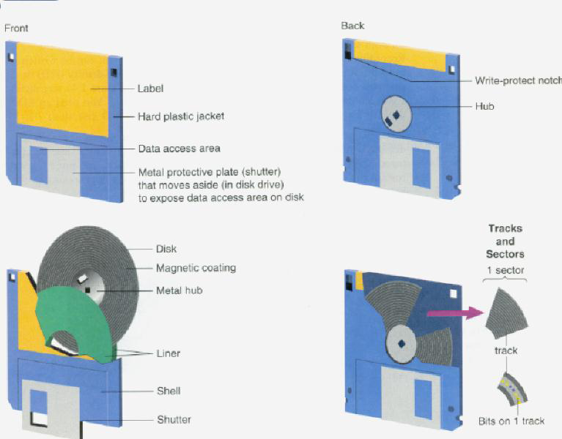
Floppy Disk (3.5”)

Slide 125
Floppy Disk
A typical 3.5” floppy disk can store up to 1.44 MB of data.
Advantages of these diskettes are that they are smaller and therefore easier to carry and since they are contained in hard plastic jackets, they are less susceptible to physical damage.
The use of diskettes is however fast fading out due to the availability of more reliable, high capacity, robust, portable and yet cheap storage devices such as the Pen drive.

Slide 126
Characteristics of Diskettes
Floppy diskettes have the following characteristics:
Tracks and sectors: Data is recorded on diskettes in concentric rings called tracks.
These tracks are too tiny to be visible to human eye and they are closed concentric rings rather than visible grooves nor a single spiral.
The number of tracks on a diskette is calculated as tracts per inch and usually referred to as tpi.
The higher the tpi, the more data the diskette can hold.

Slide 127
Characteristics of Diskettes
Each track is divided into sectors. Sectors, like tracks are invisible and are wedge shaped used by the computer for storage reference purposes.
Each sector typically holds 512 bytes of data. However, the number of sectors per tract varies according to the recording density – number of bits per inch.
Data saved on diskette are distributed by tracks and sectors on the disk.
The operating system then uses the intersection point of tracks and sectors to reference the location at which a data is stored to spin the disk and position the read-write head for a read or write operation to be performed.

Slide 128
Characteristics of Diskettes
Unformatted vrs Formatted diskette: Most diskettes today come of the factory formatted.
For a diskette to be ready for use, it has to be formatted. If not, it means you have the task to perform before you use your diskette with your computer and disk drive.
Formatting – or initializing as it known in Macintosh environment – means that you must prepare the disk for use so that the computer operating system can write information on it.

Slide 129
Characteristics of Diskettes
Unformatted diskettes are without tracks and sectors on it. By formatting the diskette you define the tracks and sectors on it as well as setting up the file allocation table (FAT) for the diskette.
To understand this better, think about a notebook of plain white pages without any ruled lines, margins, nor page numbers.
Formatting a diskette is like ruling lines and setting the left and right margin and page number for each page.

Slide 130
Optical Disks
Optical disks are removable disks on which data is written and read using laser technology – there is no mechanical arm, as it is the case with floppy disk drives and hard disks.
These disks store much more data than floppies. A single optical disk of type called CD-ROM can hold up to 700 MB of data.
This works out to 250,000 pages of text, or more than 7000 photographs or graphic objects or 19 hours of speech, or 74 minutes of video.

Slide 131
Optical Disks
The greatest advantage to optical disk is its great capacity as result of the precision of laser technology.
Recently, some manufacturers have even developed CDs that can hold as much as 6 GB.
The most notable drawback to most types of optical disks is that information cannot be changed once stored or written to the optical disk medium.
Although some disks are strictly used for digital data storage, many are used to distribute multimedia programs that combine text, visuals, and sound.

Slide 132
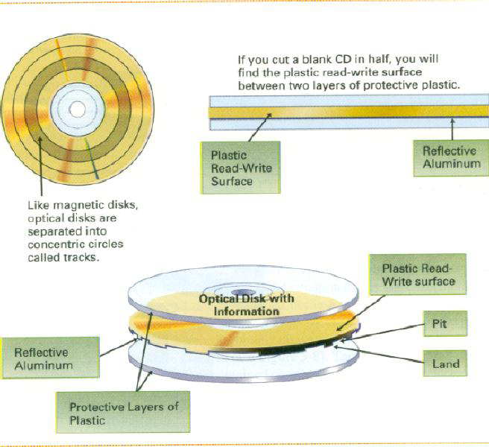
Optical Disks (Cross-section of compact disk structure)

Slide 133
Optical Disks
The structure of an optical disk is sandwich of protective plastic layers and plastic read-write surface with reflective aluminum.
The two outer layers are protective plastic, and the two middle layers are a plastic read-write surface and a layer of reflective aluminum thus making four layers.
With the principal types of optical disk technology, a high power laser beam is used to represent data by burning tiny pits into the bottom of the plastic read-write surface.

Slide 134
Optical Disks
Low power laser light scans the disk surface to read data.
Pitted areas are not reflected in the process and thus interpreted as 0 bits while smooth areas that reflect are interpreted as 1 bits.
Because the pits are so tiny, a great amount of data can be represented more than it is possible on the same amount of space on a diskette and many hard disks.

Slide 135
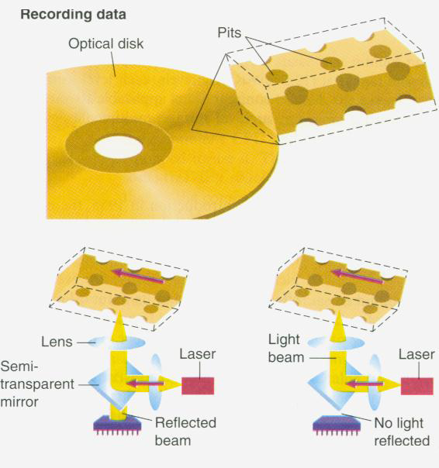
Optical Disks
High power laser beam burns pits or write on optical disk and a low-powered beam read data by reflecting smooth areas

Slide 136
Optical Disks
The main types of optical technology used with computers are:
CD-ROM disks
CD-R disks
CD-RW disks
DVD/DVD-ROM

Slide 137
CD-ROM Disks
One of the most popular of optical disks is the CD-ROM – compact disk-read-only memory.
This type is used only to hold software programs and data.
CD-ROM is much like the music CD; it is a read-only storage medium.
Read-only means once data or information – which may include visuals and sound – is written on the disk from the factory, it cannot be overwritten or erased by the user.

Slide 138
CD-ROM Disks
Most microcomputers have built-in CD-ROM drives.
Often times the drives are labeled with their speed; written as 10x, 20x, or higher. A 10x drive can access data at 1.5 megabytes per second – the equivalent of 500 typed pages of text.
The faster the drive spins, the more quickly it can deliver data to the processor.
Typical PC CD-ROM drive is used with only one disk; however, there are multi-disk drives that can handle up to 100 disks. Such drives are called jukeboxes, or CD changers.

Slide 139
CD-R Disks
CD-R, which stands for compact disk-recordable, is a CD format that allows users with CDR drives to write data, only once, onto a specially manufactured disk that can then be read by a standard CD-ROM drive.
Typical example is the Photo CD system developed by Kodak.
Photo CD technology allows photographs taken with ordinary 35 millimeter camera to be stored digitally on an optical disk.

Slide 140
CD-R Disks
CD-R are now becoming the industry standard for backing up files on the hard disk and for coping large volume of software programs and data including audio visuals.
A typical CD-R has a capacity 700 megabytes

Slide 141
CD-RW Disks
CD-RW stands for compact disk rewritable. It is sometime referred to as erasable CD.
CDRW allows users to erase data so that the disk can be used over and over again just like the pen drive.
The most common type is the magneto-optical disk which used aspects of both magnetic and optical disk technologies.

Slide 142
DVD-ROM Disks
Originally, DVD was not abbreviation for anything according to the industrial sponsors.
The letters used to be interpreted as “digital video disk” and later, when its diverse possibilities became obvious, for “digital versatile disk”.
DVD is a silvery, 5-inch optically readable digital disk that looks like an audio compact disk but can store up to 40 gigabytes, allowing great data storage, studio-quality video images, and theatre-like surround sound.

Slide 143
DVD-ROM Disks
The home-entertainment version is simply called DVD.
The computer version of DVD is called the DVD-ROM disk.
It represents a new generation of high-density CD-ROM disks.

Slide 144
Pen Drives
Pen drive is a portable USB flash memory device that can be used to quickly transfer audio, video and data files from the hard drive of one computer to another.
With a construction that is small enough to fit into a pocket, the pen drive derives its name from the fact that many of these USB drive devices resemble a small pen or pencil in size and shape.
A USB flash drive consists of a NAND-type flash memory data storage device integrated with a USB (Universal Serial Bus) interface.

Slide 145
Pen Drives
USB flash drives are typically removable and rewritable, much smaller than a floppy disk, and most USB flash drives weigh less than an ounce (30 g).
Storage capacities typically range from 64 MB to 128 GB with steady improvements in size and price per capacity.
Some allow 1 million write or erase cycles and have 10-year data retention, connected by USB 1.1 or USB 2.0.

Slide 146
Pen Drives
A flash drive consists of a small printed circuit board protected inside a plastic, metal, or rubberized case, robust enough for carrying with no additional protection—in a pocket or on a key chain, for example.
The USB connector is protected by a removable cap or by retracting into the body of the drive, although it is not likely to be damaged if exposed (but it may damage other items, for example a bag it is placed in).

Slide 147
Pen Drives
Most flash drives use a standard type-A USB connection allowing plugging into a port on a personal computer, but drives for other interfaces also exist.
Equipped with a large amount of memory capacity, the pen drive is considered to be an improvement on both the older floppy drive disks and the more modern compact disks that are often used to copy data and reload the files on a different hard drive.
Even a pen drive with a relatively low storage capacity tends to provide plenty of space for a number of files.

Slide 148
Pen Drives
The types of files that can be loaded onto a pen drive are all the common types that can be housed on any hard drive. This makes it possible for persons to copy photos, spreadsheets, word processing documents, movie clips, music tracks, and just about any other type of file.
getimage

Slide 149
The Read/Write Operations of the Hard Disks
Unlike floppies, hard disks are composed of many layers of thin but rigid metal or glass platters covered with a substance that allows data to be held in the form of magnetized spots.
Hard disks are also tightly sealed within an enclosed unit to prevent any foreign matter such as dust or smoke from getting inside.
Because hard disks have multiple double-sided platters; they can hold much more data than floppy diskettes. Capacity of hard disks keeps on soaring every year.

Slide 150
The Read/Write Operations of the Hard Disks
Today, it is not uncommon to find 160 GB hard disks.
A disk drive is a device that holds, spins, read data from and writes data to the disk.
An internal hard disk is a single unit that contains both the disk drive and the storage medium (multiple platters).
This type looks like part of the front panel of your system.

Slide 151
The Read/Write Operations of the Hard Disks
Reading data from the disk entails the data represented by magnetic spots being converted to electronic signals and transmitted to the primary storage – internal memory or RAM.
That is ‘read’ means data is copied form the disk.
‘Write’ operation entails the recording of electronic information processed by the computer onto the disk.
Data – represented as electronic signals within the computer‘s memory – is transferred onto the disk and then stored as magnetized spots. Data is read from or written onto a tape in similar fashion.

Slide 152
The Read/Write Operations of the Hard Disks
A hard disk cartridge is a disk storage device in which the disk drive is separate from the hard disk storage medium.
This type provides increased storage capacity of hard disks and ability to change disk media, as with floppy disks.
Hard card, often referred to as memory cards, this is a type of hard disk that can be added to your system by inserting it into an expansion slot.
However, hard cards do not holds as much information as other types of hard disks.

Slide 153
Detailed Operation Of The Internal Hard Disk Drive
In microcomputers, the internal drive is installed in a drive bay, a slot or opening in the computer cabinet.
A hard disk is not visible from the outside of the microcomputer; it simply looks like part of the front panel on the system cabinet.
However, in the inside are disks on a drive spindle, read-write heads mounted on an actuator (access) arm that moves back and forth, and power connection circuitry.
The disks are often 1 to 3.5” in diameter.

Slide 154
Detailed Operation Of The Internal Hard Disk Drive
The operation is much the same as for a diskette drive, with read-write heads locating specific pieces of data according to track and disk surface number.
Hard disk drives do not use the sector method to locate data. Rather, they use what is known as the cylinder method.
Because the access arms holding the read-write heads all move together, the read-write heads are always over the same track on each disk at the same time.

Slide 155
Detailed Operation Of The Internal Hard Disk Drive
All tracks with the same number, lined up one above the other, thus form a cylinder
Figure of layers of disks and Read-Write arm inside disk drive below

Slide 156
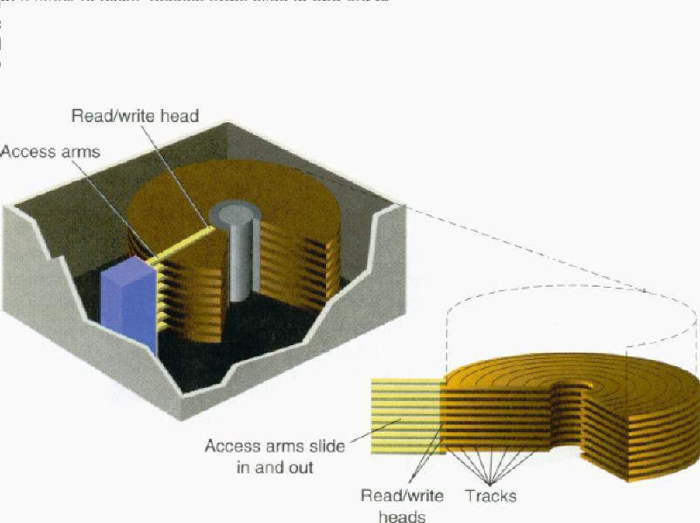
Detailed Operation Of The Internal Hard Disk Drive

Slide 157
Detailed Operation Of The Internal Hard Disk Drive
Hard disks have the advantage of capacity and speed. A typical hard disk can hold 80GB of data or above.
Seek time – the time it takes for read-write heads to move to the correct track – measured in milliseconds (1000th of a second).
Seek time for microcomputers hard disks ranges from 1 to 3ms.
After the head reaches the desired data, it must wait for the disk to rotate so the head is positioned over the correct sector; this rotation time is called latency, which may be about 1 to 2 ms for a hard drive.

Slide 158
Detailed Operation Of The Internal Hard Disk Drive
Access time is the sum of seek time and latency.
Main disadvantage of hard disk remains the possibility of head crash.
A head crash happens when the surface of the read-write head or particles on its surface come into contact with the disk surface, causing the loss of some or all of the data on the disk.
A head crash can also be caused by jarring or even power outage when the hard disk is in use.

Slide 159
Detailed Operation Of The Internal Hard Disk Drive
Hard disk crash can be disastrous particularly if the data on it has not been back up, so care has to be taken to backup your data at all times.
It is also strongly recommended that your system be always connected to an uninterrupted power supply (UPS).

Slide 160
SYSTEM SOFTWARE
Software consists of step-by-step instructions that the computer follows to perform a task or solve a problem.
Unlike hardware, software is “soft”.
Soft in the sense that the instructions they consist of are not touchable the way hardware components are.
Note that software basically consists of programs (electronically coded instructions), and not data. Hence, software is “run”, and data is “processed”.

Slide 161
SYSTEM SOFTWARE
Principally, software can be classified into three categories:
System software
Applications software
Language Translators
System software is a suite of computer programs that control and manage the basic operations of the computer and also act as interface between the user and the computer.
System software is the platform on which applications software are run.

Slide 162
SYSTEM SOFTWARE
Without the system software you won‘t be able to run any application software.
In fact, the user won‘t be able to communicate with the computer at all.
While you are using the computer or running application software, the system software is in the background making sure that the hardware carries out the tasks you want to perform.

Slide 163
SYSTEM SOFTWARE
Because system software is the closest to the hardware, it must handle a number of difficult and tedious tasks that include:
a) System Initialization: Initialization process takes place on switching on the computer system.
At this point, the system software stores the hardware configurations, for example type of monitor and amount of internal memory available, and loads the operating system.

Slide 164
SYSTEM SOFTWARE
b) Managing System Resources: This task entails controlling of the execution of the application software and coordinating how the various peripherals work together.
c) Utilities: These are subprograms that manage the interface to storage devices like the hard disk and the CD-ROM.
They also handle such tasks as file storage and retrievals, file copying, and disk formatting.
For example, when you save a Word document, the system software utility for file saving takes over and complete the task.

Slide 165
SYSTEM SOFTWARE
d) Handling Input / Output: This entails responsibilities for input and output such as reading characters from the keyboard and displaying them on the screen.
It is the system software that enables communication between the user and the computer and also between the computer and its connecting peripherals.
As a computer user, you will have to use system software, it is therefore important to understand the role it plays in the computer system.

Slide 166
SYSTEM SOFTWARE
System software comprises of a large number of program units that can be grouped into the following categories:
(i) Operating system and BIOS (Basic Input / Output system)
(ii) Device Drivers
(iii) Utility programs

Slide 167
Operating System
The operating system, popularly referred to as OS is the most important of the system software components.
The operating system can be described as the intelligence of the computer.
All the “common sense” that a computer exhibits is due to the operating system that runs it or runs on it.
It serves as the interface between the user and the machine and also enables communication between the computer and its connecting peripherals or external devices.

Slide 168
Operating System
It consists of master programs, called the supervisor, that manage the basic operations of the computer.
These programs reside in the RAM while the computer is on and provide resource management services of many kinds, handling such tasks as running and storing programs and processing data.
The operating system shields the user from the complexities of managing the computer thus enables the user to concentrate on personal task or applications.

Slide 169
Operating System
The operating system gets loaded into the RAM – the main memory – upon “booting” the computer.
Booting refers to the process of switching on the computer from the main power supply and triggering off the execution of the bootstrap loader or boot routine – instructions wired into the ROM which in turn loads the operating system automatically into the RAM or main memory (usually from the hard disk).
In the process other programs, diagnostic routines also starts up and test the main memory, the central processing unit, and other parts of the system to make sure they are all running properly.

Slide 170
Operating System
Diagnostic messages that are output of those tests are often displayed on the monitor.
Finally other programs known as device drivers are stored in the main memory that help the computer interpret, for example, keyboard characters or transmit characters to the display screen.

Slide 171
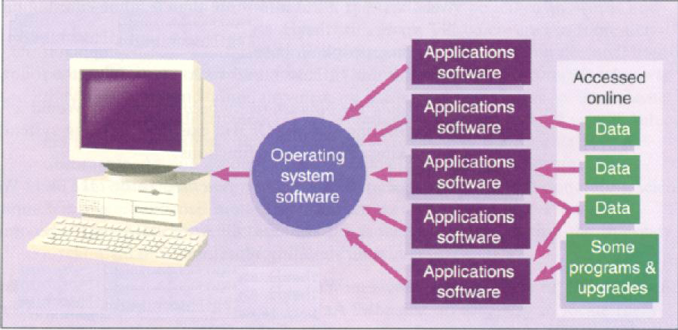
Operating System

Slide 172
Operating System
The operating systems from then on takes over the time to time running of the affairs of the system communicating with the user and performing complex tasks such as file, task, and job management.
File management involves storing and keeping track of file locations on disk, loading files form disk into the main memory and deleting files.
Task management involves the simultaneously running of more than one program and servicing the need of such programs.

Slide 173
Operating System
Job management entails managing units of work to be processed. Here job means a specified operation such as saving a document or organizing data into a document.
Another important task of the operating system is the basic input /output system (BIOS).
This consists of program modules that manage the connecting peripherals or devices such as the keyboard, monitor, disk drives and parallel and serial ports.
BIOS also manages some internal settings of the computer such as date and time.

Slide 174
Operating System
Actually, this part of the operating system resides in the ROM and runs the diagnostic test upon booting the computer after which it then loads the rest of the operating system.

Slide 175
Common Operating Systems: Platforms
The operating system a computer is running is often referred to as its platform.
However, the operating system that can be run on a computer also depends on the type or brand of its processor.
Therefore, a computer platform is defined by its processor model and its operating system.

Slide 176
Common Operating Systems: Platforms
The type of processor used in a computer determines the type of machine language it uses, and the computer‘s operating system is created to work with that particular type of machine language thereby defining the computer‘s platform – the type of architecture of the computer or family – such as the IBM PC or Apple Macintosh.
Without some form of modification or conversion, software created for one type of platform will not work for or run on another platform.

Slide 177
Common Operating Systems: Platforms
Once you understand the platform, you can begin to understand what particular computer system is capable of and what type of tasks it can be used for.
As a computer user, in addition to learning how to use your application software, you must learn to some degree, the operating system with which they work.

Slide 178
Common Operating Systems: Platforms
Today, more than half of microcomputers in the world run on Microsoft Windows.
However, popular operating systems available include the following:
* DOS
* Windows 3.X/95/NT/98/Me/2000/Xp
* O/S2
* Unix
* Mac OS
* NetWare

Slide 179
Device Drivers
Device drivers can be viewed as “divisional managers”.
When you buy an external device such as printer to connect to your computer, for the computer to be able to work with the device, there has to be some form of communication between the device and the computer.
To enable such communication, the device needs to “introduce itself” to the computer in some way specifying its nature and the “form of language it speaks”.

Slide 180
Device Drivers
Such introduction is done by special software called the device driver.
Device drivers comprise software programs that support specific peripheral devices, such as printers, CD-ROM drives, mice, and display adapter cards.
The driver contains the detail machine language necessary to control each device.
The operating system commands the driver, which in turn commands the peripheral devices.

Slide 181
Device Drivers
Most computer systems are configured with a variety of peripheral devices so that the operating system does not need to load support for all types of existing peripherals every time the computer is switched on.
It contains directions for device-specific software drivers.

Slide 182
Device Drivers
The trend now is that software companies like Microsoft enter into agreement with device manufacturers and are given the right to include drivers for their products as part of their software so that users of a particular operating system, for example Microsoft Windows, will not have to be installing drivers for some peripherals before they are able to use them.
Latest versions of Windows come packaged with hundreds of device drivers from different manufacturers so that if you are running Windows you just connect most devices to your computer and off you go.

Slide 183
Utility Programs
Utility programs act like domestic aids.
They perform such tasks as setting the dining table, cleaning the kitchen and washing of utensils before and after meals.
In computer systems, utility programs are generally used to support, enhance, or expand existing programs built in for common purposes.
They perform tasks like: system diagnostics, backup, data recovery.

Slide 184
Utility Programs
System diagnostics: In addition to the basic diagnostic routines that are performed by BIOS, more sophisticated diagnostics programs are provided in the form of a utility.
A diagnostic program compiles technical information about computer hardware, including peripherals that can be used to diagnose any technical problem.
Data Recovery: In computing there is always the danger of losing data due sudden technical problem.

Slide 185
Utility Programs
Hence the need for a kind of “disaster management” mechanism.
Data recovery utilities provide such services.
A data recovery utility program is used to restore data that has been physically damaged or corrupted.
This damaged could be as result of hardware failure like the crushing of hard disk, occurrence of power fluctuations during read/write operation or even by virus infection.

Slide 186
Utility Programs
Virus Protection: We have come to be living in a dangerous world as a result of our own deeds and misdeeds, and just as human beings, computer programs and data are not left out in susceptibility to virus infections.
A virus – in the world of computers – consists of hidden, destructive programming instructions that are buried within a program or data file.
Often, they multiply by copying themselves to other programs, causing havoc.
Sometimes the virus is merely a simple prank that pops up as a message.

Slide 187
Utility Programs
Other times too, it can destroy programs and data and wipe out the hard disk clean.
Just as human virus spread when people dine and wine indiscriminately and unprotected, computer virus spread when people exchange storage devices such as pen drives or download (make copies of) files from computer networks or the internet just any how.
Antivirus utility program scans hard disks, pen drives, and memory to detect, give information of possible virus behavior, and destroy viruses.

Slide 188
Utility Programs
Backup: For fear of ever persisting menace of data loss due unforeseen circumstances such as those mentioned in previous sections, it important to always backup – make duplicate copies of – important programs and files, so that in the event of any loss of data you can fall on the duplicate copies to recover the files.
Backup utility programs are meant for such purposes.

Slide 189
Utility Programs
Defragmentation: The file management part of the operating systems tries to store the element of data contiguously in memory.
However, this is not always possible due to frequent moving of data in and out of memory as a result of processing.
After several save and delete operations, there remain many scattered areas of stored data that are too small to be used productively.
This is referred to as fragmentation.

Slide 190
Utility Programs
High degree of fragmentation causes the computer to run slower than if all data in a file were stored together in one location.
Utility programs known as defraggers provide the service of defragmenting the disk, thus rearranging the data so that the data units of each file are repositioned together contiguously in one position on the disk.

Slide 191
Utility Programs
There are many other utilities on the market as third party software, such as those for transferring files back and forth between a desktop microcomputer and a laptop, and also Antivirus software like Norton and McAffee Antivirus tool kits.

Slide 192
Language Translators
Language translators are generally used by Computer Programmers.
These programmers normally write Computer Programs using languages such as COBOL, FORTRAN, C++, Visual Basic, etc in which instructions are written close to mathematical and English-like expressions.
These instructions tend to be meaningful to the programmer and not the computer as the computer understands only the machine language.

Slide 193
Language Translators
Since the program is not in the language that the Computer has been designed to understand, there is the need to have a program translator.
A program translator may be defined as any computer package capable of translating a source program written in either a high level language or an assembly language into a machine language.
As mentioned earlier, to date, the Computer only understands instructions written using zeros and ones.

Slide 194
Language Translators
Apart from the machine language, the other programming languages do not use only zeros and ones.
This means that whenever one writes his or her own Computer programs, there is the need to have the instructions translated into zeros and ones so that the Computer can understand.
A translator capable of translating symbols and numbers into zeros and ones are therefore needed.
Fortunately, early programmers have designed a number of translators to translate the programs that we write into machine language.

Slide 195
Language Translators
Presently, we have Computer programmers who continue to write better translators or improve on the existing translators.
Since these translators are computer programs, they are usually referred to as program translators.
There are three types of program translators namely Compilers, Interpreters and Assemblers.

Slide 196
INTERPRETER
Most of the early microcomputers were programmed in BASIC language and equipped with an interpreter (BASIC interpreter) stored in a Read Only Memory (ROM) chip.
Every program instruction is translated or interpreted on each occasion the program is run (not just once initially as with assemblers and compilers).
If any statement does not conform to or violates the rules or grammar (syntax) of the language an error message is displayed on the screen.

Slide 197
INTERPRETER
Until this error is corrected, program execution cannot proceed and this has the disadvantage of slowing down the running of the program.
An interpreter, however, allows errors to be corrected more quickly than a compiler which prints a (long) list of errors which have to be corrected as a whole rather than individually before program execution can continue.

Slide 198
ASSEMBLER
This type of software translates and assembles a program written in assembly code into machine (object) code.
The assembler translates the symbolic function codes into the equivalent machine operation code; symbolic addresses are allocated actual internal memory locations.
After assembling, the object program is retained on a storage device in machine code.

Slide 199
ASSEMBLER
Errors are diagnosed during the assembly process. This is a once only process and does not have to be performed each time a program is run as with an interpreter.
Assembly programs tend to run faster than interpreted ones, because assembly language is low level and nearer to machine code and fewer instructions are necessary to accomplish a desired result.

Slide 200
COMPILER
This is another translation program for compiling high level language instructions into machine code.
A compiler has more capabilities than an assembler because each source program instruction generates a number of machine code instructions.
A compiled program may not be so efficient in the time taken to process a task because of the nature of the high level language used, COBOL for instance.
This results in more detailed and less direct instructions than those generated by an assembled program written in assembly code.

Slide 201
COMPILER
A compiler is usually used together with a program called the linker, capable of linking together the different translated modules.
The use of a linker makes it possible for standard functions (provided by the compiler developers) to be added to one's program to make it a complete working program.
The output of the linker is the executable version of the source program.

Slide 202
APPLICATION SOFTWARE
Prospective buyers often agonize over what and what specifications must their computers have for months.
However, it is rather your choice of software that really determine the utility or usefulness of your computer.
Application software – users‘ tool – is what makes your computer tick besides system software. Application software is special computer programs that are specifically designed and written to perform specific tasks.

Slide 203
APPLICATION SOFTWARE
These software can be acquired directly form the software manufacturers or companies or even vendors that specialized in the sale and support of microcomputer hardware and software.
There are thousands of programs to choose from – games alone numbered over 2500 – and some of them can make life easier and more productive than you can imagine.

Slide 204
APPLICATION SOFTWARE
Application software are those designed to be used by a user for a specific purpose.
For example, if a user wishes to type a document, then he/she would need a Word Processor which is an application software that allows a computer user to use his/her Computer in the same manner as he/she would have done using a typewriter.
Below are some of the major application software classes.

Slide 205
Common Features of Application Software
Since the advent of Windows operating systems, all window based application software developed exhibit many similarities and functionalities that are characterized by the underlying operating system‘s graphical user interface.
Some common features of application software are ■ Windows
■ Scroll bar
■ On-line Help Menu/Screen

Slide 206
Common Features of Application Software
■ Menus / Menu bar
■ Dialog box
■ Icons
■ Macros
■ Tool Buttons
■ OLE
■ Toolbars
■ Clipboard
■ Cursors
■ tutorial / documentation

Slide 207
Common Features of Application Software
Windows:
A window is a rectangular screen display of a running program or opened document or file with a title bar on top.
Several windows may overlay each other or cascaded alongside one another depending on the number of executing task.
Each window may show a different application display, such as a word processing document and a spreadsheet document.

Slide 208
Common Features of Application Software
Menu/Menu bar:
A menu bar is a row of menu options displayed across the top or the bottom of the screen.
A menu is a list of command options or choices. Various tasks that can be performed in an application are grouped under different names or titles.
These names or titles are then used to form the menus.
To perform some particular task, click the mouse button on the menu option to open the menu containing the task and then select that particular task.

Slide 209
Common Features of Application Software
Icons:
An icon is a small on-screen pictorial object that represents a program or a file.
Icons serve as short-cut way to access the target programs or files and are therefore referred to as short-cuts.
Tool buttons:
These are simulated buttons are provided to serve as quick way of executing commands.

Slide 210
Common Features of Application Software
They are often small graphic objects arranged on toolbars.
Tool buttons when clicked with the mouse triggers off execution of the commands associated with them.
Tool bars:
A toolbar is arrow of on-screen tool buttons, displayed below the menu bar, and used to activate a variety of functions of the applications program.
They can be customized and move around the screen.

Slide 211
Common Features of Application Software
Cursors:
The cursor, sometimes referred to as the insertion point, is the blinking movable vertical or horizontal line symbol on the screen that indicates where the next data is entered.
You can move the cursor around using either the mouse or the directional arrows on the keyboard.

Slide 212
Common Features of Application Software
Scrollbars:
Scrolling is the way to quickly move through text in a document or the active file upward or downward.
Using the directional arrow keys or a mouse, you can scroll through the display screen and into the text above and below.
However, when you have to scroll through a large file that spans many pages, it is easier to using the scrollbars.

Slide 213
Common Features of Application Software
There are vertical scrollbars as well as horizontal scrollbars.
Vertical scrollbars often appear at the right side of the document screen small triangular arrows pointing up and down.
To scroll up (or view the bottom part of document), simply click the left mouse button on the down-pointing small triangular arrow of the scrollbar.
To view the top part of document scroll down by clicking the up-pointing small triangular arrow of the scrollbar.

Slide 214
Common Features of Application Software
Horizontal scrollbars often appear below a document window and are used to scroll the document window right or left.
Dialog box:
A dialog box is a window through which the user provides some needed information that the computer or the application program require to perform some task.
It also used to display helpful messages at times.

Slide 215
Common Features of Application Software
Macros:
Series of steps that may be needed to perform a task can be grouped together in a way and the entire routine assigned a keystroke.
Pressing the Ctrl key on the keyboard in combination with the assigned key triggers the execution of the programmed routine assigned to the keystroke.
These programmed steps are referred to as macros.

Slide 216
Common Features of Application Software
OLE (Object Link and Embedding):
This feature enables the user to link and/or embed document of one application program such as a spreadsheet to or in another such a word processor.
Changes made to the embedded object affect only the document that contains it.
If the object was rather linked, then changes made to the object are automatically made in all the linked documents that contain it.
Thus OLE facilitates sharing and manipulating of information.

Slide 217
Common Features of Application Software
An object may be a document, worksheet, picture or even a sound recording.
Clipboard:
During working sessions, it sometimes become necessary to copy an item or part of a document from one document and then paste it into another document or application or even in another part of the same document to save time and labor.
The area in the memory where the copied item is held temporarily before and even after it is pasted to a destination is known as the clipboard.

Slide 218
Common Features of Application Software
Tutorial and Documentation:
This resembles the on-line Help but rather acts like an electronic instruction book or program that takes you through a prescribed series of steps to help you learn the product.
Tutorials are supplemented with documentation.
Documentation is a user manual or reference manual that is a narrative and graphical description of a program.
It may be instructional but often features and functions are grouped by category for reference purposes.

Slide 219
Common Features of Application Software
Documentation may come in booklet form or on diskette or CD-ROM; it is sometimes also available on-line from the manufacturer.
On-line Help Menu and Screen:
A Help menu offers a choice of help screens – specific display of explanations of how to perform various tasks, such as setting the page lay-out of a document, embedding picture objects and many more.
On-line help screens mostly can be displayed by opening the Help menu on the menu bar or clicking on the F1 function key on the keyboard.

Slide 220
Common Features of Application Software
Help screens serve like electronic reference manual.
Sometimes, on-line help may also come in the form of a wizard – in-built program that leads the user through a series of questions to determine exactly what the user‘s problem really is.
Word Processing Software:
The traditional machine for typing out documents was the typewriter.
However, the machine has long out-lived its usefulness.

Slide 221
Common Features of Application Software
In fact, if you have a manual typewriter, pray that it never break down – a prayer that may never be granted anyway – for it is becoming as difficult to get it repaired as it is to find a blacksmith.
Today word processing is what is in vogue.
Word processing software allows you to use computers to create, edit, store, and print documents.
The user can easily insert, delete, and move words, sentences, and paragraphs – without ever using an eraser.

Slide 222
Common Features of Application Software
Word processing programs also come with several features for “dressing up” documents with variable margins, font types and sizes, and styles.
All these can be done by the user on screen in “wysiwyg”– what you see is what you get – fashion, meaning the screen displays documents exactly as it will look when printed.
Word processing offers additional features such as spelling checkers and thesaurus.
Among popular word processors are Microsoft Word, Lotus Word Pro, and WordPerfect.

Slide 223
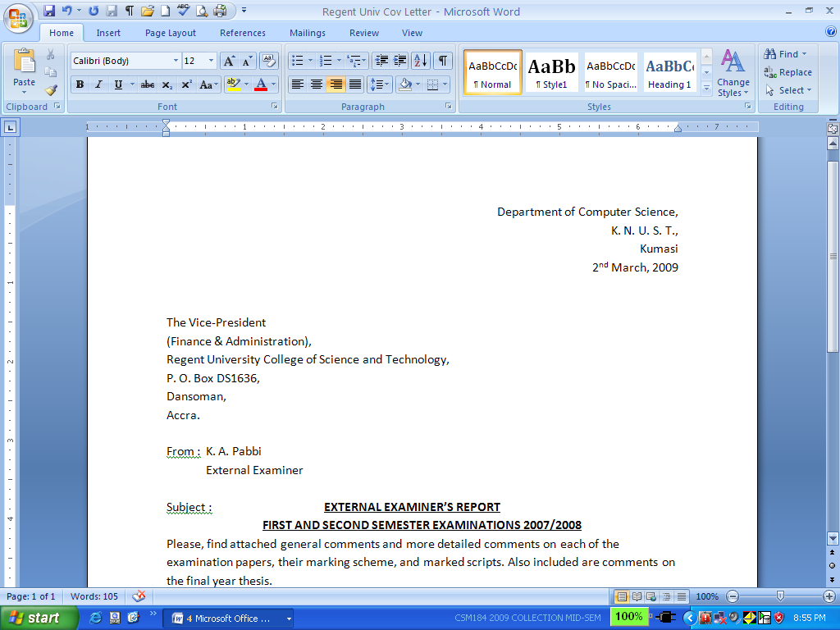
Common Features of Application Software

Slide 224
Common Features of Application Software
Spreadsheet Software:
Traditionally, a spreadsheet was a grid of rows and columns, printed on special green paper, which was used by accountants and others to produce financial projections and reports.
Accounting personnel using the spreadsheet often spend long hours and days penciling tiny numbers into countless tiny rectangles.
When one figure changed, all the computations on the sheet had to be done all over again.

Slide 225
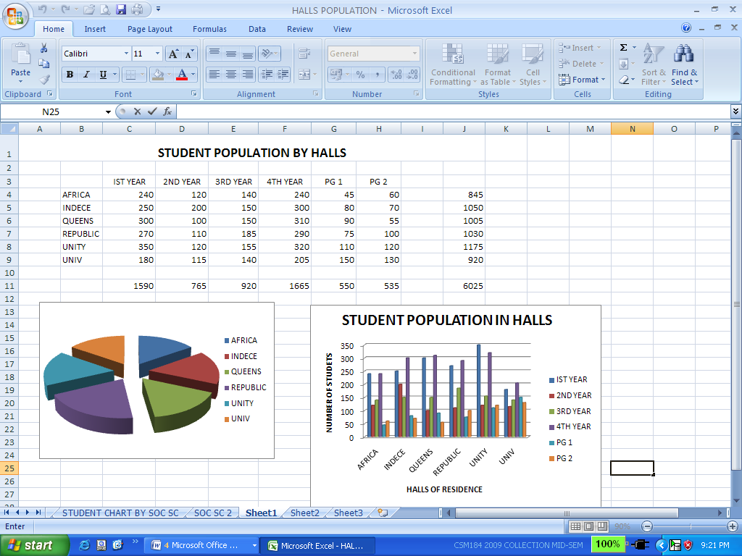
Common Features of Application Software

Slide 226
Common Features of Application Software
An electronic spreadsheet allows users to create tables and financial schedules by entering data into rows and columns arranged as a grid on a display screen.
The electronic spreadsheet is computerized and largely incorporates automation of computations.
This software tool quickly became the most popular small-business program, and has been held directly responsible for making the microcomputer a widely used business tool.
Today, the principal spreadsheet programs include Microsoft Excel, Lotus 1-2-3, and Quatro Pro.

Slide 227
Common Features of Application Software
Presentation Software:
Presentation software are software tools designed to use graphics and data/information from other applications or software tools to communicate or make a presentation to audience such as clients, supervisors, directors, or even students in a lecture theatre.
Presentations software may make use of some analytical graphics such as charts but they usually look much more sophisticated, using, for instance, different texturing patterns, color, and three-dimensionality.

Slide 228
Common Features of Application Software
Presentation graphics are output as 35mm slides, which can be projected on a screen or displayed on a large monitor.
Presentation software packages often come with slide sorters, which group together a dozen or more slides in miniature.
The person making the presentation can use the mouse to click a slide to bring it up for viewing.
Some also include clip art (grouped art works) that can be electronically cut and pasted into the graphics.

Slide 229
Common Features of Application Software
Depending on the system‘s capability, you can add text, animated sequences, and sound.
Examples of well-known presentation software packages are Microsoft PowerPoint, Aldus Persuasion, Lotus Freelance Graphics, and SPC Harvard Graphics.

Slide 230
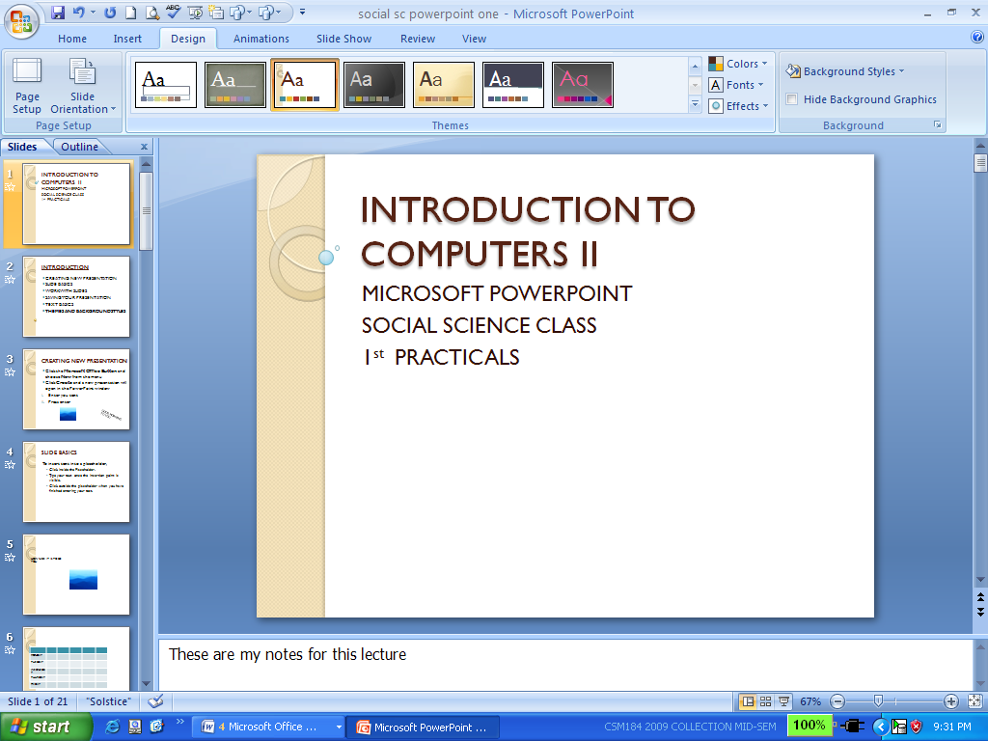
Common Features of Application Software

Slide 231
Common Features of Application Software
Database Management System Software:
Generally speaking, a database is any electronically stored collection of data in a computer system.
To be more specific however, a database can be described as a collection of interrelated files in a computer system.
These computer-based files are organized according to their common elements or fields, easy retrieval.

Slide 232
Common Features of Application Software
Database Management System (DBMS) software, therefore, is a program that controls the structure of a database and access to the data.

Slide 233
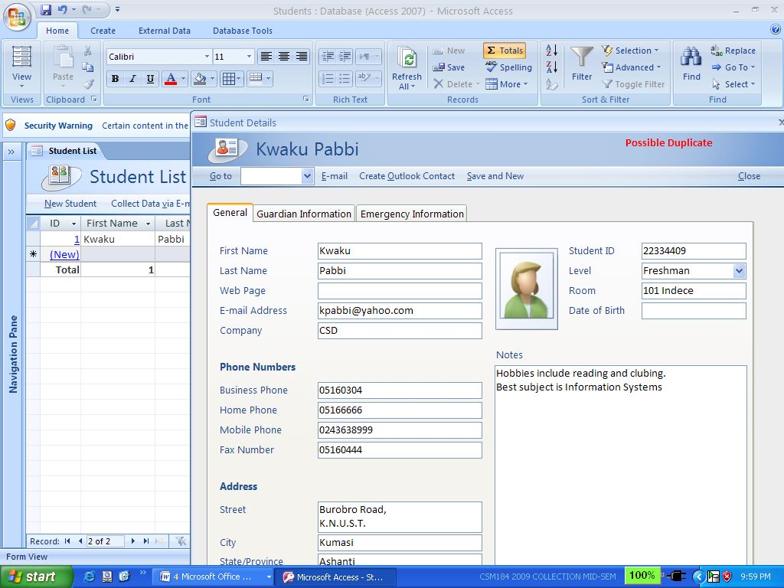
Common Features of Application Software

Slide 234
Common Features of Application Software
A DBMS has several advantages over the traditional file managers or flat-file management
system. A DBMS can access several files at one time as against file manager that can access
only one file a time. Also, you can not extract information across more than one file with the
flat-file system while this can be easily accomplished with a DBMS. For example, using a
file manager or the flat-file system, you could call up a list of all Faculty of Science students.
You could also call the list of all Africa Hall students. But you could not extract all Faculty
of Science students resident in Africa Hall. A DBMS allows you to do that and even more.

Slide 235
Common Features of Application Software
Databases are getting more and more sophisticated. Some years back, they included only text.
Today, they incorporate new data types – not only texts but also pictures and even sound, and animation.
Some popular database management software include Microsoft Access, Microsoft Visual FoxPro, Paradox, and Claris Filemaker Pro.

Slide 236
Common Features of Application Software
Statistical Packages:
These packages are used by Computer users for statistical analysis and also for producing different types of graphs.
They can be used for performing regression analysis, computation of statistical parameters such as the mean, median, standard deviation, kurtosis, skewness, etc.
They can also be used for solving systems of linear equations, etc. Typical examples of statistical packages are SPSS PC+, MathLab, MINITAB, MATHEMATICA, SAS, etc.

Slide 237
Common Features of Application Software
Accounting Packages:
These are packages designed to be used by Companies and individuals for accounting purposes.
Thus, these packages can be used in preparing documents such as Trial Balance, Balance sheet, Statement of account, Invoices, etc.
They can be used by individuals at home in tracking their daily transactions or income and expenditure.
Examples of these packages are SAGE Accounting, CA-Simply Accounting, MS Money, Quicken, etc.

Slide 238
Common Features of Application Software
Communication Packages:
These are software packages that allow two or more Computer users to communicate with one another if the necessary hardware components are in place.
Examples of these packages are Derlina WinFax, EUDORA, INTERNET in a Box, etc.
Web Browsers:
These are packages that enable one to surf or browse the internet for data, information, chatting, sending and receiving emails, etc.

Slide 239
Common Features of Application Software
Some of the commonly used web browsers are Yahoo, Netscape, Explorer, Mozilla Firefox, Google, etc.

Slide 240
COMPUTER NETWORKS
A network is basically a combination of hardware and software that send data from one computer to another.
It can also be defined as two or more computers that are connected to each other to share and exchange data.
The hardware consist of the physical components that carries data or signals from one point to the other while the software are the instructions that make the services expected from a network possible.

Slide 241
COMPUTER NETWORKS
A computer network must meet a number of criteria, notable among these are performance, security and reliability.
Performance is normally measured in terms of transit time and response time.
The transit time is the time it takes data to travel from one computer to the other while the response time is the time elapse between an enquiry and response.
The performance of a network can be affected by the number of people on the network at a time, the transmission medium, etc.

Slide 242
COMPUTER NETWORKS
Security basically deals with preventing unauthorized users to access, update or damage data.
It also deals with the policies needed for implementation and procedures needed for recovery from breaches and data loses.
Reliability is usually measured by the frequency at which failure occurs, the time it takes the network to recover from a failure and the network‘s robustness in an emergency or disaster.

Slide 243
COMPUTER NETWORKS
Type of connections:
As mentioned earlier, a network consists of two or more devices that have been connected through links to send and receive data.
A link is simply a communication pathway for transferring data from one device to another.
There are basically two types of connections namely point-to-point and multipoint connections.
For a point-topoint connection, there is a dedicated link between two devices and the entire capacity of the link is set aside for transmission between these two devices.

Slide 244
COMPUTER NETWORKS
A multipoint connection on the other hand is one in which more than two devices share a common link.

Slide 245
NETWORK TOPOLOGY
A network topology refers to the way in which the network devices are connected to each other.
When two or more devices are connected they form a link, and one or more links form a topology.
In a network the devices are normally referred to as nodes.
There are basically four main types of networking and these are the mesh, star, bus and ring.

Slide 246
MESH TOPOLOGY
In a mesh topology each device has a dedicated point-to-point link to all other devices in the network.
In other words, there is a direct connection between every two devices on the network.
A typical mesh topology is as shown below:

Slide 247
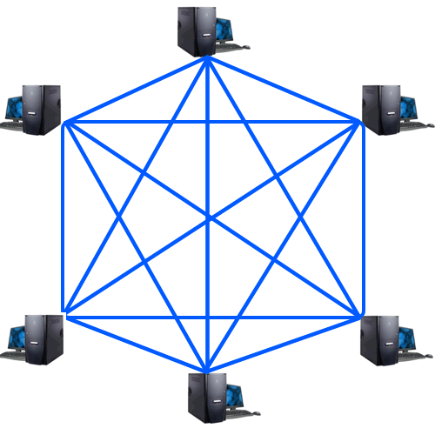
MESH TOPOLOGY

Slide 248
STAR TOPOLOGY
In a star topology, each device has a dedicated point-to-point link only to a hub; a central controller.
In other words, there is no direct link between any two devices.
A typical star topology is as shown below:

Slide 249
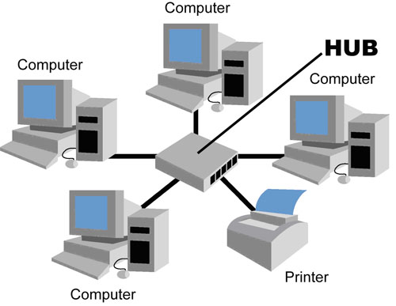
STAR TOPOLOGY

Slide 250
BUS TOPOLOGY
In a bus topology one long cable called the bus cable is used to link all the devices in a link.
The bus topology is a multipoint.
Each device is connected to the bus cable by drop lines and connectors (taps)

Slide 251
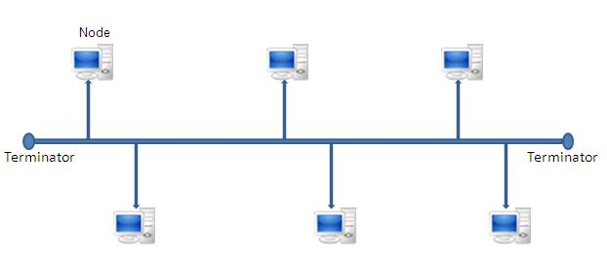
BUS TOPOLOGY

Slide 252
THE WINDOWS OPERATING SYSTEM
Whenever a new computer is purchased, an operating system has to be installed on the Computer before the Computer can be used.
One of the most popular operating system is the Windows.
The operating system is a software package that enables you to communicate with your computer by way of running application programs.
There are different versions of the Windows such as Windows 98, Windows 2000, Windows XP and Windows Vista.

Slide 253
Windows as an Operating System
Unlike Disk Operating System (DOS) that allows you to run a single application at a time, the Windows operating system has multitasking capabilities, meaning that it can run several application programs at the same time.
For the purpose of this course we will consider Windows XP as it is more popular than the other versions. Every operating system must be able to perform the following functions:

Slide 254
Windows as an Operating System
Manage the Computer resources such as the memory, the processor, date files and the other hardware devices.
Allocate resources for use.
Must have a policy such as round robin, first-in-first-out, etc in deciding who to allocate a resource to when multiple requests for a particular resource are made at the same time.
Reclaim resources after use.

Slide 255
The Windows XP Desktop
All the different versions of Windows use a desktop for the standard interface.
Think of the desktop as workspaces where you can access everything that is on your computer.
For example, using your desktop it is possible to access your disk drive, run an application program, access the internet, change your computer settings, etc.
The desktop contains three main items namely the start button, the taskbar and icons.

Slide 256
The Windows XP Desktop
Start button: This is the most important tool you will frequently use while working in Windows XP.
Whenever the start button is clicked, it gives you the option of running a program, logging off so that another user can use the Computer and turning your computer off when you no longer wants to use it.
Taskbar: This bar enables a computer user to switch between open programs and windows.

Slide 257
The Windows XP Desktop
Remember we have already said that Windows is multitasking and therefore one can have a number of programs opened at the same time and is the taskbar that makes it possible for you to switch between the programs.
Icons (or graphical pictures): These are normally small graphical images or pictures that represent applications, files, and other parts of the operating system.

Slide 258
The Windows XP Desktop
For example, one of such icons is the Recycle Bin where all files that are deleted are temporary stored, another is my Computer which makes it possible to access information on the different drives of your computer.

Slide 259
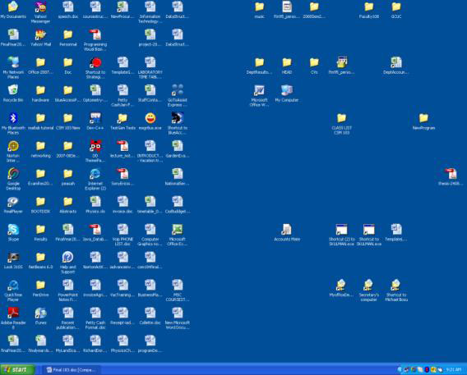
The Windows XP Desktop

Slide 260
The Start Menu
The start menu is basically used to explore Windows.
Also, any application program that does not have a shortcut on the desktop can only be run by first clicking at the start and then selecting the appropriate options.
The start menu appears when the start button is clicked.

Slide 261
The Start Menu
When the start menu opens, you will see on the left side the list of programs on your computer and the right side gives you access to the common Windows folders such as My Documents, Control Panel, Help and Support, Search, and Run.
The All Programs when highlighted gives you a pop-up menu of all application programs and utility programs that have been installed on your computer.

Slide 262
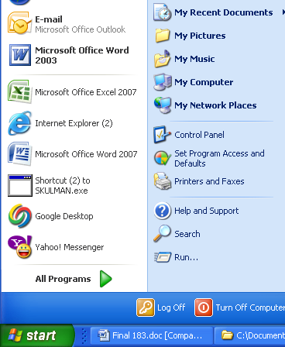
The Start Menu
One good thing about the start menu is that it is able to keep track of items you've recently opened and places the icon on the Start menu so that you can easily open it the next time you open the Start menu.

Slide 263
The Icons
These are the small pictures on the desktop.
Some of the icons are for objects.
Object icons allow you to open programs and files. Examples of object icons include My Computer, Recycle Bin, and Internet Explorer.
Non object icons are normally shortcut icons and these allow you to run application programs or open files quickly.
The shortcut icons are those with little arrow in the left corner.
Adding or deleting an icon does not affect the programs on your computer but just the link.

Slide 264
Opening a program using an icon
There are many ways that one can run a program. If the program has an icon, then its best to open the program using its icon.
To do that,
Place your mouse over the icon of the program you intend to open.
Then, double-click the icon.

Slide 265

The Taskbar
The taskbar is the small blue bar that appears you see at the bottom of your desktop.
It contains the Start menu and the Quick Launch bar, which contains icons for Internet Explorer, Windows Media Player, and Show Desktop.
Click an icon to open a program. Click Show Desktop to quickly view your desktop without closing any programs or windows.
Figure 7.3 The Start button and Quick Lunch toolbar on taskbar

Slide 266
The Taskbar
The box on the right is called the Notification Area. This area shows the clock and several other icons depending on what one has installed on his/her computer.
Figure7.4 Notification Area on Taskbar
For example, if you have installed yahoo messenger and an anti virus software on your computer then icons for these will also appear in the Notification Area detailing the status of these software.

Slide 267
The Taskbar
Also, when you are printing a document, the printer icon appears and disappears when the printer finishes with the printing.
Microsoft and other software developers also use the Notification Area to remind you when software updates are available for download.
Whenever you open or minimize a window or program, a rectangular button appears on the taskbar that shows the name of the application.
However, these buttons disappear when you close a window.

Slide 268
Log On/Off and Switch Users
Any Computer that is running Windows XP can be used by more than one person at a time.
For example you may have one Computer in your room mates.
In order to keep record of each others information on the shared Computer such as your unique settings, email account and documents, Windows XP allows everyone who uses your computer to have separate computer accounts.
To use your account, you will have to log on and you will have to log off after you have finished using your computer.

Slide 269
Log On/Off and Switch Users
Windows XP even enables you to log off the computer so someone else can log on without having to restart the computer.
Switching user means changing users.
Note that for a particular PC only one user can use the Computer at a time.
However, if two or more people have already log on to the same Computer, only one of them can be active at a time, therefore, anytime someone else intends to use the Computer he/she must switch to his/her account on the Computer.

Slide 270
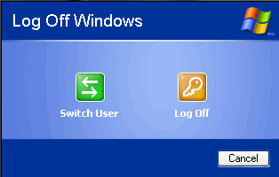
Log On/Off and Switch Users
To log off/switch users:
Figure 7.5 Log Off Windows dialog box

Slide 271
Log On/Off and Switch Users
Click the Start menu and click Log Off.
A dialog box appears asking you if you want to Switch User or Log Off.
Switch User allows someone else to log on to the computer.
If you choose to Switch User, your applications will continue to run in the background while the new user logs on.
If you choose Log Off, your applications will close and you will have to log on and run your applications again if you have to do so.

Slide 272
Log On/Off and Switch Users
In any case, you are taken to a Windows XP log on screen where you are prompted to enter your username and password.
Note that if the username and/or the password provided is incorrect Windows XP will deny you access to the Computer.
You must therefore remember your password at all times.

Slide 273
Turning Off and Restarting the Computer
Any time you finished using a Computer, you must turn it off.
The following is the correct procedure for turning off a Computer.
Failure to do so may at times result in loss of data or file.
For example, whenever you turn your computer off by switching the power off you are likely to damage your Windows XP and the next time you turn your Computer on Windows XP will display a message that you did not turn off your computer the proper way and will you like to start your computer in a ‘safe’ mode?

Slide 274
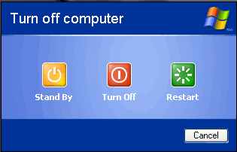
Turning Off and Restarting the Computer
Starting a Computer in a safe mode causes most of your hardware devices not to function properly since the drivers for these devices may not be loaded
To turn off the computer:
Click the Start menu.
Click Turn Off Computer.
A dialog box opens. Click Turn Off.
Figure7.6 Turn Off computer dialog box

Slide 275
Turning Off and Restarting the Computer
To restart the computer: Most of the time, after you have installed a new driver or program, you are prompted to re-start your computer.
This is to enable the Computer to recognize the new device whose drivers have just been installed.
The procedure for re-starting a computer is as follows:
Click the Start menu.
Click Turn Off Computer.
A dialog box opens as above. Click Restart.

Slide 276
Running Programs
Running a Computer (application) Programs enable you to do work on the computer.
On your Computer every application program has been installed for a particular work.
For example, if you intend to type a document then you will have to install a word processor such as Microsoft Word on your Computer.
You can easily run a program from the Start menu using the All Programs button.

Slide 277
Running Programs
To run a program using the Start menu:
Click Start.
Click All Programs and move the mouse pointer over the program you intend to run (it turns blue).
Click to run the program you have highlighted. (Note that programs with small black arrows beside them will open another cascading menu. Just drag your mouse pointer to make your selection.)
To close a program, click the located at the top right of the window.

Slide 278
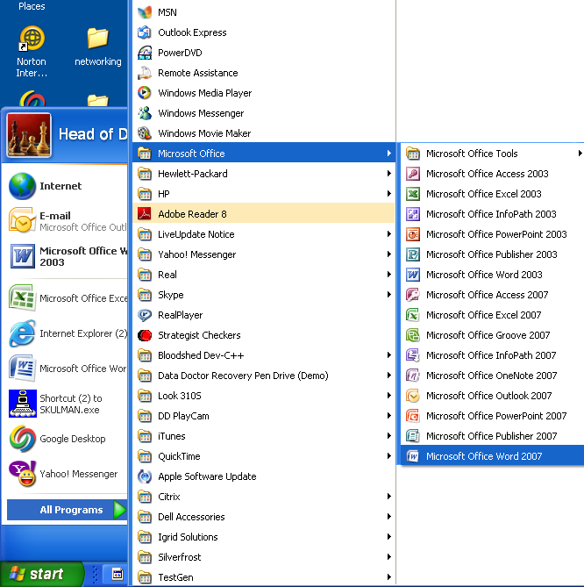
Launching Microsoft Word from the Start menu
Figure7.7 The windows XP Start menu with All Programs option selected

Slide 279
Launching Microsoft Word from the Start menu
To run the Microsoft Word 2007 these are the steps needed:
Click Start
Select/Highlight All program (it turns blue)
Move mouse pointer over to Microsoft Office (it turns blue)
Move mouse pointer over Microsoft Office Word 2007 (it turns blue)
Click the highlighted Microsoft Office Word 2007, and the application will run.

Slide 280
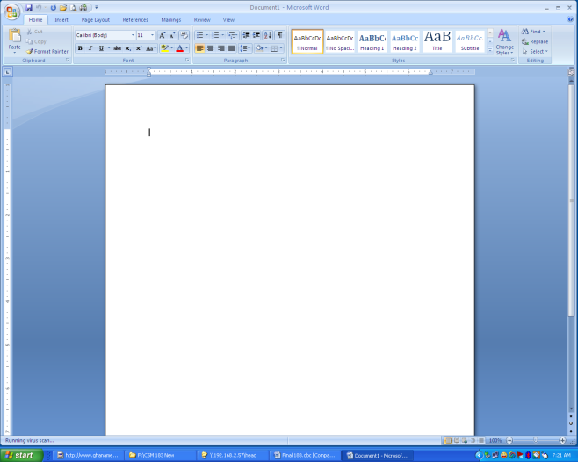
Windows XP Bars and Buttons
Windows XP got its name from one of its most basic elements: the window.
The rectangular work area for a program, file, or other task is called a window.
Figure 7.8 Microsoft Word Initial Screen showing a blank Workspace

Slide 281
Windows XP Bars and Buttons
On going through the steps above to run Microsoft Office Word 2007 for example, you will obtain the screen (window) to the left.
The three buttons at the top left of the window (title bar) are the Windows XP buttons.
The white area inside the window is the workspace where you do your work with the program, such as typing a letter.
Note that the workspace appears different for different programs.

Slide 282
Windows XP Bars and Buttons
There are several other several Windows XP tools, menus, and commands that make the operating system easy-to-use.
The title bar is the horizontal blue bar at the top of a window. By default, it displays white text on blue background.
Figure 7.9 The Title Bar at the top of a Window

Slide 283
Windows XP Bars and Buttons
The Control menu button is the icon at the far left end of the title bar. The Control menu button opens a menu you can use to control the window.
The Close button is at the far right end of the title bar. It is usually a red box with an X in it. It is used to close a window whenever one does not intend to use the window again by just clicking the Close button.
The first two left buttons shown here are the Minimize and Maximize buttons respectively.

Slide 284
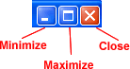
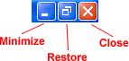
Minimizing, Maximizing, and Restoring Windows
With Windows XP, you can easily enlarge, hide, or shrink a window using the Minimize, Maximize, and Restore buttons.
The Minimize button is the leftmost of the three buttons at the right end of the title bar.
This button has a small dash (or minus sign).
Figure7.10 Minimize, Maximize, and Restore buttons

Slide 285
Minimizing, Maximizing, and Restoring Windows
The Minimize button shrinks the window and places it on the taskbar while leaving the program running at the background.
The Maximize button which is to the immediate right of the minimize button, looks like a small window, It is used to enlarge a window to cover the entire desktop (screen).
After a window is maximized, the Maximize button changes to the Restore button which looks like two windows near one another.

Slide 286
Minimizing, Maximizing, and Restoring Windows
If you click the Restore button, the maximized window shrinks to its previous size (the size it was before you maximized it).
Note that when a window is maximized, you can double click the title bar to restore the window to its previous size and if you double click again the window will be maximized.

Slide 287
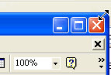
Sizing Windows
Sometimes you might want to see to opened windows on your screen at the same time.
If you use maximize or restore you can only see one screen at a time.
However, you can manually resize the open windows so that you can see all of them at the same time. Sizing window is slightly different from minimizing, restoring, or maximizing.
Note: You cannot size a window if it has been maximized.

Slide 288
Sizing Windows
To resize a window,
Move the mouse pointer over any corner or border of the window.
The mouse pointer changes into a double-headed arrow pointing either up and down, left and right, or diagonal if the mouse pointer is move over the bottom or top, left or right, or a corner respectively.
You should always make sure that the mouse pointer changes to a double-headed arrow before you proceed to the next step.

Slide 289
Sizing Windows
Click and hold down the left mouse button.
Drag the double-headed arrow out or in to make the window larger or smaller.
Release the mouse button when the window is the size you want.
Alternatively, you can also resize a window by the following method:
Right click any blank area of the title bar.
Select move from the menu options.

Slide 290
Sizing Windows
Press either the Up or Down arrow key of your keyboard if you want the window to be longer or shorter.
You are to press the left or the right arrow key if you want the window to be wider or narrower.
This locks the one side of the window to the mouse pointer such that as the mouse pointer is moved around the window resize.
Click the left button of the mouse when the desired size is obtained.

Slide 291
Sizing Windows
Before clicking at the left mouse button, you can press the escape (Esc) key if you change your mind on resizing so as to return your window to its initial size.

Slide 292
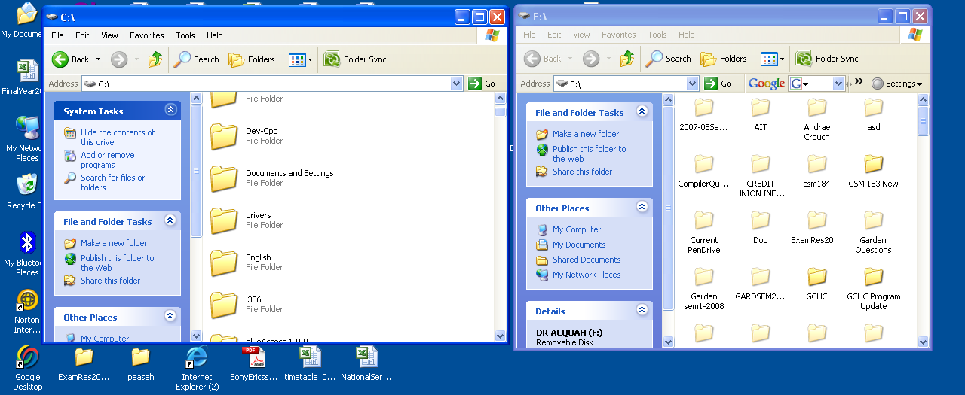
Moving a Window
Figure 7.11 Two Windows placed side by side on the Desktop

Slide 293
Moving a Window
Sometimes one window may obscure another window or an item you want to click on or view.
For example, if you open two windows (of two disk drives) and you want to copy a file from one window to the other, it will be easy if the two windows can be seen at the same time (as shown above).
Therefore, if one of the windows is overlapping on the other window then one or more of the windows must be moved so that all windows can be see at the same time.

Slide 294
Moving a Window
To move a window,
Place the mouse pointer over the title bar (at the top of the window).
Click and hold down the left mouse button. (Note that you cannot move a window that has been maximized)
Drag the window to the place where you want it and release the mouse button.
Alternatively, you can also move a window by the following method:
Right click at any blank area of the title bar

Slide 295
Moving a Window
Select move from the menu options
Press any of the cursor control movement (arrow) keys of your keyboard to lock the window to the mouse pointer.
Simply move the mouse pointer where you want the window to be. Note that as you move the mouse pointer anywhere on the desktop the window to be moved moves accordingly.
Click the left button of the mouse when the desired position is obtained.

Slide 296
Moving a Window
Before clicking at the left mouse button, you can press the escape (Esc) key if you change your mind on moving the window so as to return your window to its initial position.

Slide 297
Switching Between Windows
Windows XP allows you to have more than one program or window opened at the same time so that you can easily move between open windows if the need be.
The window you select becomes the active window. To know that a window is active on the desktop, its title bar is deep blue.
When a window is inactive, the title bar is light blue.

Slide 298
Switching Between Windows
To switch between windows you will have to
Open all the required windows.
Size the windows, if necessary, so they are open on the desktop.
Click on any part of the window you want to work with and this will make the window the active one.
To make a different window the active one simple repeat the third step above.
OR
Simple click the required program/window button on the taskbar to activate the window you want to work with.

Slide 299
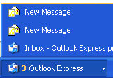
Switching Between Windows
Unlike previous versions of Windows, Windows XP keeps the taskbar from getting too cluttered.
It groups the buttons when you open too many windows such that all the names cannot appear on the task bar. For example, when you open Outlook Express, you will see one button on the taskbar.
Figure 7. 12 Grouped |Buttons on Taskbar

Slide 300
Switching Between Windows
However, if you have three or more email message windows open, one button represents the Outlook Express's open windows as shown in the figure on the left.
You can open any of the windows by first clicking at the Outlook Express button on the task bar.
This pops up a list of open windows within Outlook Express.
Simply move the mouse pointer over the required window and click the left button of the mouse.

Slide 301
Switching Using the Keyboard Method
When you have more than one window open, you can also switch between them using the keyboard.
Using the mouse is faster however if you do not have a mouse then you may have to use your keyboard.
To do so using the keyboard,
Open the required programs or windows.
Press and hold down the Alt key while pressing the Tab key.
A menu containing all files and program icons appear.

Slide 302
Switching Using the Keyboard Method
While holding down the Alt key, keep Tabbing to the window you want to view or open. Once it is selected, release both keys.

Slide 303
More Windows XP Bars and Buttons
The menu bar is a very important bar and lies just below the title bar. It contains several menus, which let you see a list of commands.
Figure 7.13 The Menu Bar

Slide 304
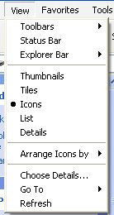
More Windows XP Bars and Buttons
Some menu options are followed by ellipsis, or... Choosing a menu option followed by ellipses will open a dialog box, which feature helpful tools to help you perform tasks.
Choosing a menu option followed by an arrow head displays another set of menu options to choose from.
Figure 7.14 Menu options showing ellipsis and arrow heads

Slide 305
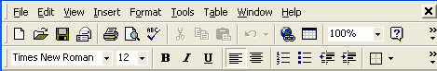
More Windows XP Bars and Buttons
Some Windows XP programs (such as Microsoft Word have toolbars across the top of the window.
The toolbar buttons allow you to print, cut, paste, or do other tasks.
The options vary depending on the program.
Figure 7.15 Microsoft Word Toolbar

Slide 306
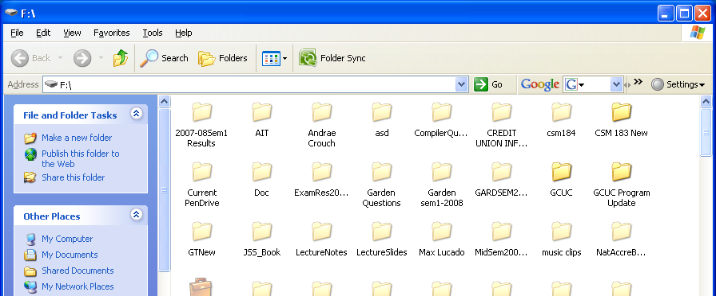
Scrolling
Figure7.16 Window showing vertical Scroll Bar

Slide 307
Scrolling
Whenever for a particular window, one cannot see all the information within the window at the same time, Windows XP displays the scroll bar at the right side or the bottom of a window.
This is to make it possible for you view the hidden information by either moving the vertical scrollbar up or down, or by moving the horizontal scroll bar left or right depending on where the hidden information is.
It is especially convenient when viewing a long document.

Slide 308
Scrolling
To scroll,
Click the arrow to scroll up.
Click the arrow to scroll down.
Click the arrows to scroll up one page at a time.
Click the arrows to scroll down one page at a time.
Click the button to open a browse menu.
OR
Click and drag the scroll bars to view your document.

